Slide 1



THE FAST & EASY PATH TO PEACE & CALM
FREEDOM FROM STRESS
THE ULTIMATE PATH TO PEACE
With Emotional Freedom Techniques (EFT) & Energy Flow®

Slide 2

Certified by and original © 2025 all rights reserved to vitalitylivingcollege.info.
Notes:
Are you stressed at work?

Slide 3

Certified by and original © 2025 all rights reserved to vitalitylivingcollege.info.
Notes:
Feeling overwhelmed in life?

Slide 4

Certified by and original © 2025 all rights reserved to vitalitylivingcollege.info.
Notes:
Perhaps you are feeling lost and it is all getting too much. You need a break. Now!

Slide 5

Certified by and original © 2025 all rights reserved to vitalitylivingcollege.info.
Notes:
Perhaps financial worried are bothering you?

Slide 6

Certified by and original © 2025 all rights reserved to vitalitylivingcollege.info.
Notes:
Or you feel stressed out as a parent and what is happening with the kids?

Slide 7

Certified by and original © 2025 all rights reserved to vitalitylivingcollege.info.
Notes:
Or the real strain in your life is to do with relationships.

Slide 8
Certified by and original © 2025 all rights reserved to vitalitylivingcollege.info.
Notes:
Or the real strain in your life is to do with relationships.

Slide 9

Certified by and original © 2025 all rights reserved to vitalitylivingcollege.info.
Notes:
Or health.
Share your personal woe to wow story about overcoming stress here
Woe to wow sample
Deadlines were piling up, my phone wouldn’t stop buzzing, and a good night’s sleep felt like a thing of the past. My stress had a tight grip around my chest, squeezing out every drop of joy from my days. Still, I refused to admit it. Until finally, enough was enough. The constant stress had taken a toll on my body. And I had to admit that it wasn’t, in fact, okay at all.
As I searched for a way to restore my health without giving up my working, I stumbled upon EFT.
Though I was skeptical about it at first, since I’d never heard of something like this before, I gave it a shot. As I tapped, something unexpected happened: the iron grip of tension began to ease, replaced by a surprising wave of calm. It wasn’t an overnight miracle, but tapping has become my go-to tool to bust through stress. Now, each day, I tap, I breathe, and I face whatever comes with a newfound strength and good physical and mental health.

Slide 10
THE ULTIMATE PATH TO EMOTIONAL FREEDOM
THIS MASTERCLASS IS FOR THOSE WHO WANT TO:
Experience calm and gain freedom from stress.
Understand what is stress and how it is affecting your life.
Learn practical ways to cope with stress to lead a calmer life.
Explore Energy Flow® and Emotional Freedom Techniques (EFT) to find harmony, peace and balance.
Certified by and original © 2025 all rights reserved to vitalitylivingcollege.info.

Slide 11

Unlock the door to emotional
freedom and master peace
and calm.
Certified by and original © 2025 all rights reserved to vitalitylivingcollege.info.

Slide 12
THE ULTIMATE PATH TO EMOTIONAL FREEDOM
IN THE NEXT 90 MINUTES, YOU WILL LEARN:
The root cause of stress & illness.
Ways to reverse the negative effects of stress.
What is Energy Flow® and how it can relieve stress.
The 4 transformational ways to let go of stress and find calm.
How Energy Flow® and Emotional Freedom Techniques (EFT) can help.
Certified by and original © 2025 all rights reserved to vitalitylivingcollege.info.
Notes:
3-4 main bullet points of what you will cover during the 45 minutes that answers the prayer of your avatar, solves the problem and makes them feel good that there is a solution to what they are seeking.

Slide 13
THE ULTIMATE PATH TO EMOTIONAL FREEDOM
HOUSE RULES FOR TODAY’S MASTERCLASS
A dynamic training, NOT just a soothing talk.
About active involvement, NOT passive listening for calm.
Focused on tools and techniques, NOT quick fixes.
A confidential space of learning and growth, free from judgement.
Not therapy, but a place to experience, learn and grow.
Certified by and original © 2025 all rights reserved to vitalitylivingcollege.info.
Notes:
The house rules are where you lay the expectations of what someone can expect and not expect from the Presentation. It pre-frames what the presentation is and what it is not.
Use 3 bullet points for house rules explaining what the presentation is not.
And 1 bullet point explaining who they need to show up to get the most out of it. This is combing a towards and away from the message.

Slide 14
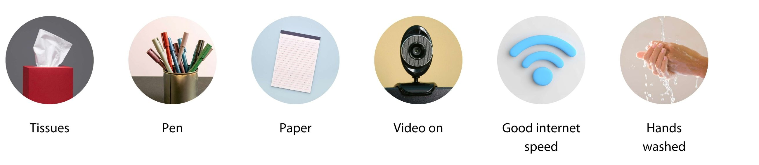
THE ULTIMATE PATH TO EMOTIONAL FREEDOM
OUR AGREEMENT
Treat it like a live in-person masterclass
No phones to be used during the masterclass
Please keep the following ready or prepared:
Certified by and original © 2025 all rights reserved to vitalitylivingcollege.info.
Notes:
The house rules are where you lay the expectations of what someone can expect and not expect from the Presentation. It pre-frames what the presentation is and what it is not.
Use 3 bullet points for house rules explaining what the presentation is not.
And 1 bullet point explaining who they need to show up to get the most out of it. This is combing a towards and away from the message.

Slide 15

THE ULTIMATE PATH TO EMOTIONAL FREEDOM
DOES THIS SEEM LIKE YOU?
Feeling overwhelmed by daily pressures and stress.
Seeking a way to manage stress effectively and regain control over your well-being.
Certified by and original © 2025 all rights reserved to vitalitylivingcollege.info.
Notes:
Use bullet points to explain the emotions of the pain, problem, prayer. This is basically the current situation or where they are now and giving them, some hope of where they could be. But basically, it’s about where they are now.

Slide 16

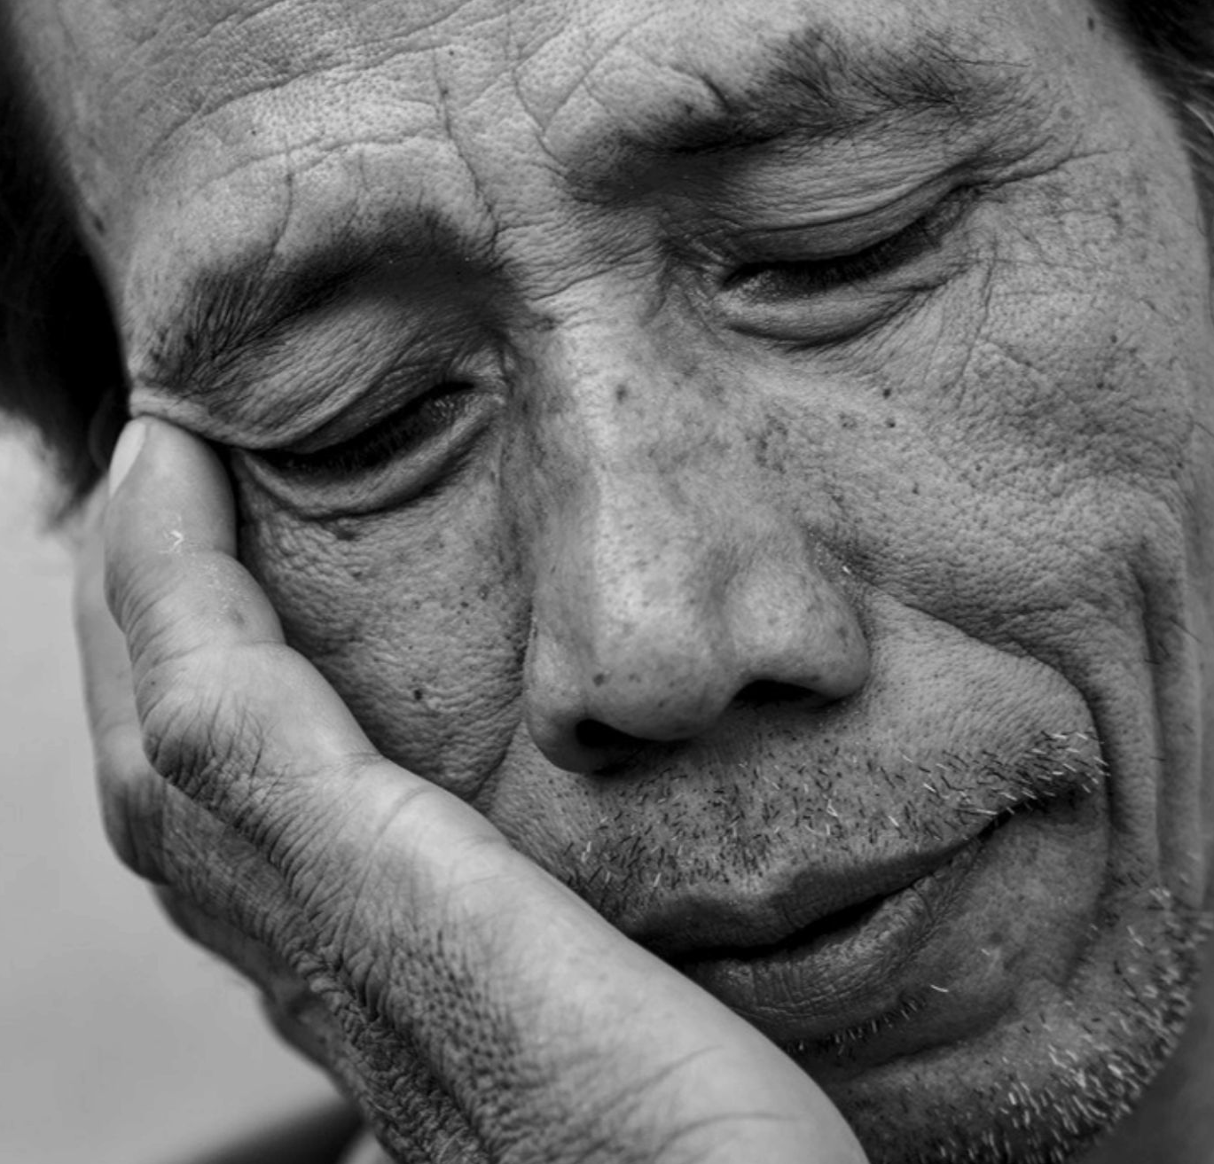
THE ULTIMATE PATH TO EMOTIONAL FREEDOM
DOES THIS SEEM LIKE YOU?
Struggling to find calm in hectic moments.
Wishing for a well-balanced life that is free from constant worry and tension.
Certified by and original © 2025 all rights reserved to vitalitylivingcollege.info.
Notes:
Use bullet points to explain the emotions of the pain, problem, prayer. This is basically the current situation or where they are now and giving them, some hope of where they could be. But basically, it’s about where they are now.

Slide 17
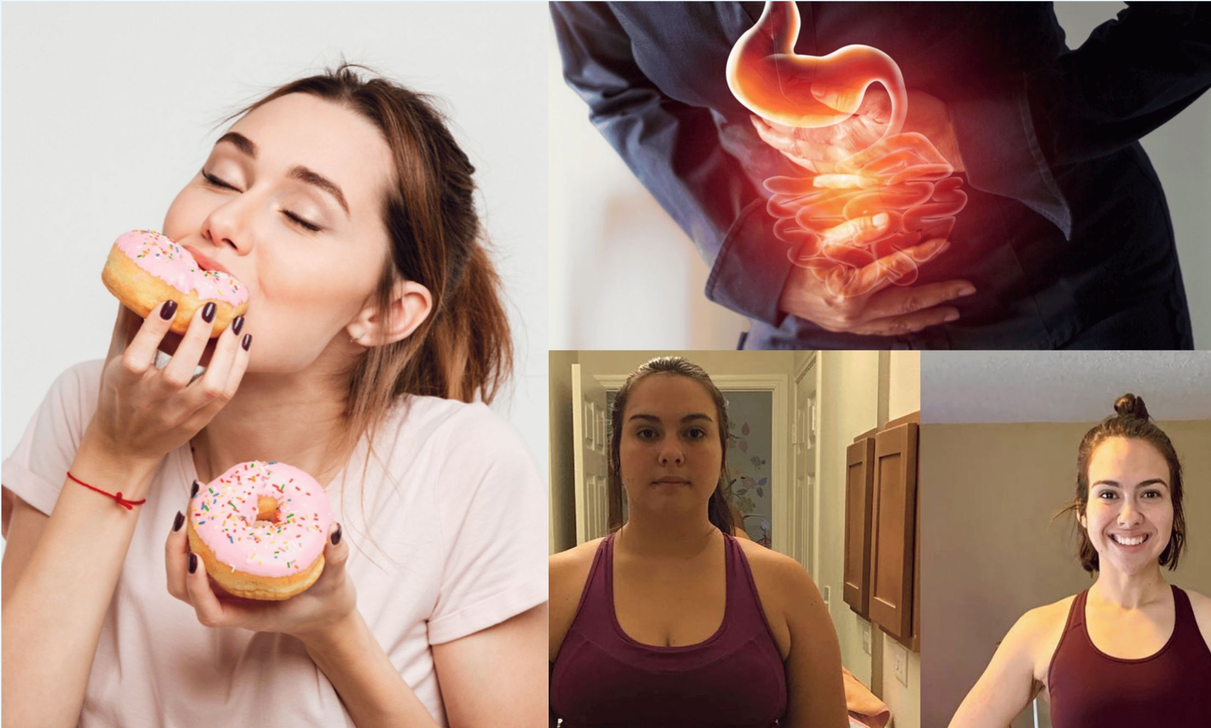
THE ULTIMATE PATH TO EMOTIONAL FREEDOM
DOES THIS SEEM LIKE YOU?
Reaching out to sugary or savoury treats as a means of coping.
Have digestive challenges.
Difficulty losing weight.
Certified by and original © 2025 all rights reserved to vitalitylivingcollege.info.
Notes:
Use bullet points to explain the emotions of the pain, problem, prayer. This is basically the current situation or where they are now and giving them, some hope of where they could be. But basically, it’s about where they are now.

Slide 18
THE ULTIMATE PATH TO EMOTIONAL FREEDOM
The real problem is that stress has become
“normal”…expected, instead of something that is
actively cleaned — just like brushing your teeth.
Certified by and original © 2025 all rights reserved to vitalitylivingcollege.info.
Notes:
This summarises the pain and problem of the current situation and what life would be like when they move to the desired situation. It’s like the current model is pain and the future or desired model is a pleasure. You planting the seed for a possible future.

Slide 19
THE ULTIMATE PATH TO EMOTIONAL FREEDOM
Stress often masksunprocessed emotions like
anger, sadness, irritation, worry, grief, loss,
and can show up as overthinking, procrastination,
low confidence, money worries, relationship fights,
and worse still illness or a health issue.
Certified by and original © 2025 all rights reserved to vitalitylivingcollege.info.
Notes:
This summarises the pain and problem of the current situation and what life would be like when they move to the desired situation. It’s like the current model is pain and the future or desired model is a pleasure. You planting the seed for a possible future.

Slide 20

A state of mental or emotional strain or tension resulting from adverse or demanding circumstances.
Certified by and original © 2025 all rights reserved to vitalitylivingcollege.info.
Notes:
Mind reading
Take an audit over here

Slide 21

Reducing stress is important because it protects your mental and physical health, helping you stay calm, focused, and resilient.
Certified by and original © 2025 all rights reserved to vitalitylivingcollege.info.
Notes:
This summarises the pain and problem of the current situation and what life would be like when they move to the desired situation. It’s like the current model is pain and the future or desired model is a pleasure. You planting the seed for a possible future.
WHY IS REDUCING STRESS IMPORTANT?

Slide 22

85%
of illness is
stress related!
Certified by and original © 2025 all rights reserved to vitalitylivingcollege.info.
https://vitalitylivingcollege.info/how-emotional-stress-can-make-you-sick/
Notes:
Reference: Centre for Disease Control (CDC)

Slide 23

90%
of doctor visits are
stress related!
Certified by and original © 2025 all rights reserved to vitalitylivingcollege.info.
https://vitalitylivingcollege.info/how-emotional-stress-can-make-you-sick/
Notes:
“Early investigations confirmed physicians’ fears they were being inundated, for it was found that 60% of all visits were by patients who had nothing physically wrong with them. Add to this the medical visits by patients whose physical illnesses are stress related (peptic ulcer, ulcerative colitis, hypertension, etc.) and the total approaches a staggering 80 to 90% of all physician visits. Surprising as these findings were 25 years ago, nationally accepted estimates today range from 50 to 80% (Shapiro, 1971).” https://www.linkedin.com/pulse/citations-90-all-doctors-office-visits-stress-related-tom-beckman/

Slide 24

LEADING CAUSE
of divorce, weight gain, obesity & addictions
Certified by and original © 2025 all rights reserved to vitalitylivingcollege.info.
https://vitalitylivingcollege.info/how-emotional-stress-can-make-you-sick/
Notes:
“Early investigations confirmed physicians’ fears they were being inundated, for it was found that 60% of all visits were by patients who had nothing physically wrong with them. Add to this the medical visits by patients whose physical illnesses are stress related (peptic ulcer, ulcerative colitis, hypertension, etc.) and the total approaches a staggering 80 to 90% of all physician visits. Surprising as these findings were 25 years ago, nationally accepted estimates today range from 50 to 80% (Shapiro, 1971).” https://www.linkedin.com/pulse/citations-90-all-doctors-office-visits-stress-related-tom-beckman/

Slide 25

SUPPRESSED
EMOTIONS
increase risk of cancer by 70%
and heart disease by 47%
Certified by and original © 2025 all rights reserved to vitalitylivingcollege.info.
https://vitalitylivingcollege.info/the-5-reasons-why-shutting-down-emotions-can-harm-you/

Slide 26

UNRESOLVED
past trauma can lead to illness
Certified by and original © 2025 all rights reserved to vitalitylivingcollege.info.
Notes:
https://www.cdc.gov/violenceprevention/aces/about.html

Slide 27
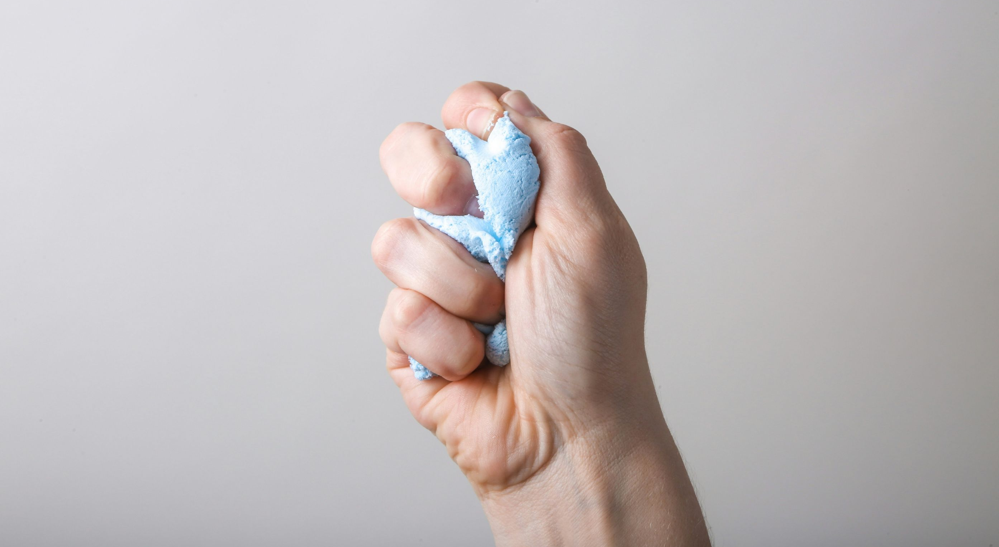
UNEXPRESSED ANGER
is known to be linked to cancer
Certified by and original © 2025 all rights reserved to vitalitylivingcollege.info.
https://vitalitylivingcollege.info/the-5-reasons-why-shutting-down-emotions-can-harm-you/
Notes:
Optional: If you have any scientific facts for the pain, problem and how not solving the current situation might be detrimental.
Add references.
Unexpressed anger can lead to illness and disease.
Reference: https://vitalitylivingcollege.info/the-5-reasons-why-shutting-down-emotions-can-harm-you/

Slide 28

UNFORGIVENESS
can lead to diabetes, pain and heart attack
Certified by and original © 2025 all rights reserved to vitalitylivingcollege.info.
https://vitalitylivingcollege.info/the-5-reasons-why-shutting-down-emotions-can-harm-you/

Slide 29
THE ULTIMATE PATH TO EMOTIONAL FREEDOM
You might be stuck in an
“Old No Control Model” of stress, bouncing
between feeling overwhelmed, irritable, and anxious
or trying to keep it all bottled up, and have
not moved to the “New FREEDOM Model” where
you release stress, regulate emotions, resolve the past,
express emotions and forgive with ease.
Certified by and original © 2025 all rights reserved to vitalitylivingcollege.info.
Notes:
Optional: If you have any scientific facts for the pain, problem and how not solving the current situation might be detrimental.
Add references.
Unexpressed anger can lead to illness and disease.
Reference: https://vitalitylivingcollege.info/the-5-reasons-why-shutting-down-emotions-can-harm-you/

Slide 30

THE ULTIMATE PATH TO EMOTIONAL FREEDOM
MY BLOOD PRESSURE STABILISED AND I LOST WEIGTH
"My blood pressure stabilised, by letting go of stressful emotions that were holding me back, using the methods I learned during the program. Plus, I shed a significant amount of unwanted weight by letting go of the toxic emotions that were holding me back."
Babita Kapoor, Therapist, India
Certified by and original © 2025 all rights reserved to vitalitylivingcollege.info.
Notes:
A front-facing picture with good lighting is best.

Slide 31
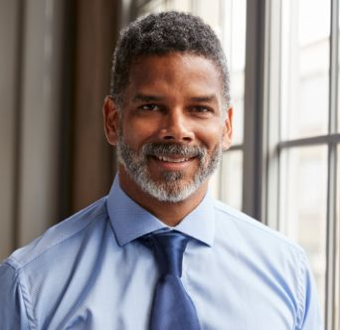
THE ULTIMATE PATH TO EMOTIONAL FREEDOM
17 YEARS OF TENSION MELTED AWAY IN 1 SESSION
“I felt like a ticking time bomb. Work stress bled into my home life, and I'd snap at my family over the smallest things. The guilt ate at me, but I couldn't seem to break the cycle. After the program, I was shocked to find 17 years of tension melt away in one session. I can finally show my family my love and enjoy quality time together. Now I have the tools to handle my stress - calmly and with a smile.”
Sam Josef, Chief Executive, USA
Certified by and original © 2025 all rights reserved to vitalitylivingcollege.info.
Notes:
A front-facing picture with good lighting is best.

Slide 32

THE ULTIMATE PATH TO EMOTIONAL FREEDOM
HAPPIER RELATIONSHIP WITH HUSBAND
“I changed my relationship with stress overnight, from feeling overwhelmed to feeling in control. The practical techniques and insights on stress that I acquired have empowered me to manage my stress and lessen its impact on my health and relationships, where I have a happier relationship with my husband. I'm grateful for the journey and the positive impact it's had on my life.”
Mary Lu, VP Marketing, Thailand
Certified by and original © 2025 all rights reserved to vitalitylivingcollege.info.

Slide 33

THE ULTIMATE PATH TO EMOTIONAL FREEDOM
FEEL GENUINELY “ZEN” VERSUS FAKING IT!
“As a yoga instructor, I always thought I handled stress well. But lately, the pressure to be "zen" for everyone else took its toll. Even at home, I felt like I was constantly performing. My anxiety skyrocketed, and even sleep meditations weren't helping. With EFT & Energy Flow® I was able to identify my triggers before they take over and I also found the root cause behind my anxiety. It feels amazing to be genuinely zen, not just pretend to be.”
Sarah James, Yoga Instructor, UK
Certified by and original © 2025 all rights reserved to vitalitylivingcollege.info.
Notes:
A front-facing picture with good lighting is best.

Slide 34
THE ULTIMATE PATH TO EMOTIONAL FREEDOM
SUMMARY OF PAST SITUATION TO NEW SITUATION
A front-facing picture
with good lighting
is best.
“Their quote in italics, pick the parts that relate to what the presentation is about. Make sure the spelling and grammar are correct and delete parts that do not relate. This must relate to your audience and begin with them and not about you. So, if the testimonial started with, [YOUR NAME] was fantastic, delete it. You can keep that for a later section, if needed.”
Name, Designation, City, Country
Certified by and original © 2025 all rights reserved to vitalitylivingcollege.info.

Slide 35
THE ULTIMATE PATH TO EMOTIONAL FREEDOM
ONCE YOU MOVE TO THE NEW MODEL, YOU WILL:
Learn to work with your nervous system, not against it.
Regulate your emotions instead of suppressing them.
Find your body feels safe enough to relax.
Explore the underpinning root causes of stress.
Actively release stress and lay the foundation for wellness versus illness.
Feel at peace — not because life got easier, but because you got freer.
No longer wait for calm — you create it from within.
Certified by and original © 2025 all rights reserved to vitalitylivingcollege.info.
Notes:
This clearly paints a picture of the future and use words that engage visual, auditory and kinesthetic senses.
The more sensory - based you can make it, the better.
Connect with the feelings and when you talk about it bring those feelings in.
It’s like a checklist of what will happen when they move to their desired situation.

Slide 36

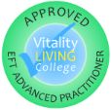

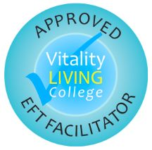
THE ULTIMATE PATH TO EMOTIONAL FREEDOM
YOUR NAME
Your past situation (woe).
Your changed situation with EFT Tapping (wow).
What you do now (information on credibility and reputation).
YOUR PIC
Certified by and original © 2025 all rights reserved to vitalitylivingcollege.info.
Notes:
Example of Woe to wow story:
Diagnosed with Cancer in 2001, then self-healed with alternate therapy and coaching.
Used to get a daily migraine, debilitating pain in the neck and shoulders.
Learned a clinically proven technique, EFT Tapping, which calms down stress in seconds to have no more migraines.
Has coached and supported 1000s of people in one-to-one sessions and trained over 20,000+ people to feel calm, healthy, happy and at peace.

Slide 37

THE ULTIMATE PATH TO EMOTIONAL FREEDOM
DR RANGANA RUPAVI CHOUDHURI (PHD)
Diagnosed with Cancer in 2001, then self-healed with alternate therapy and coaching.
Used to get a daily migraine, debilitating pain in the neck and shoulders.
Learned a clinically proven technique, EFT Tapping, which calms down stress in seconds to have no more migraines.
Have coached and supported 1000s of people in one-to-one sessions and trained over 43,000+ people to feel calm, healthy, happy and at peace.
Certified by and original © 2025 all rights reserved to vitalitylivingcollege.info.
Notes:
Example of Woe to wow story:
Diagnosed with Cancer in 2001, then self-healed with alternate therapy and coaching.
Used to get a daily migraine, debilitating pain in the neck and shoulders.
Learned a clinically proven technique, EFT Tapping, which calms down stress in seconds to have no more migraines.
Has coached and supported 1000s of people in one-to-one sessions and trained over 20,000+ people to feel calm, healthy, happy and at peace.

Slide 38
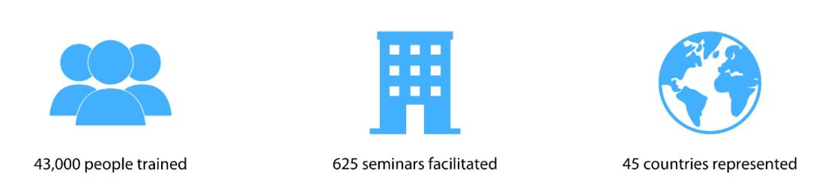
THE ULTIMATE PATH TO EMOTIONAL FREEDOM
ABOUT VITALITY LIVING COLLEGE®
Vision
To have a Practitioner or Coach in every educated household
Mission
To transform lives through emotional well-being Personal Development and Spiritual Growth Seminars, with training certifications
Certified by and original © 2025 all rights reserved to vitalitylivingcollege.info.

Slide 39
THE ULTIMATE PATH TO EMOTIONAL FREEDOM
SO, WHAT’S THE NEW MODEL?
There are 4 transformationalways to release stress, regulate emotions versus suppress, resolve the past, express emotions and forgive.
Certified by and original © 2025 all rights reserved to vitalitylivingcollege.info.

Slide 40
THE ULTIMATE PATH TO EMOTIONAL FREEDOM
1
Learn how to release stress quickly
and safely with Energy Flow®.
Certified by and original © 2025 all rights reserved to vitalitylivingcollege.info.

Slide 41
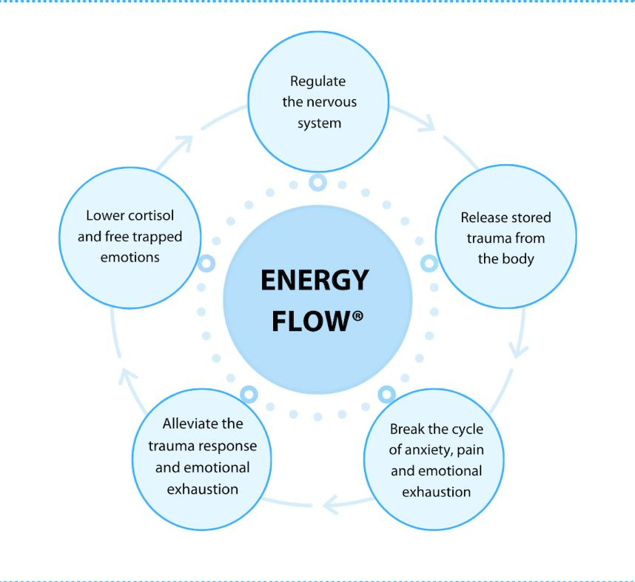
THE ULTIMATE PATH TO EMOTIONAL FREEDOM
Certified by and original © 2025 all rights reserved to vitalitylivingcollege.info.

Slide 42
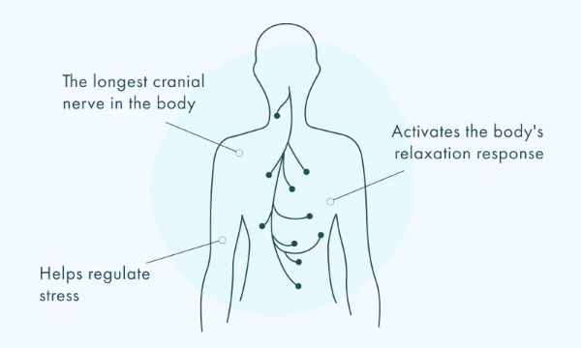
THE ULTIMATE PATH TO EMOTIONAL FREEDOM
Certified by and original © 2025 all rights reserved to vitalitylivingcollege.info.

Slide 43
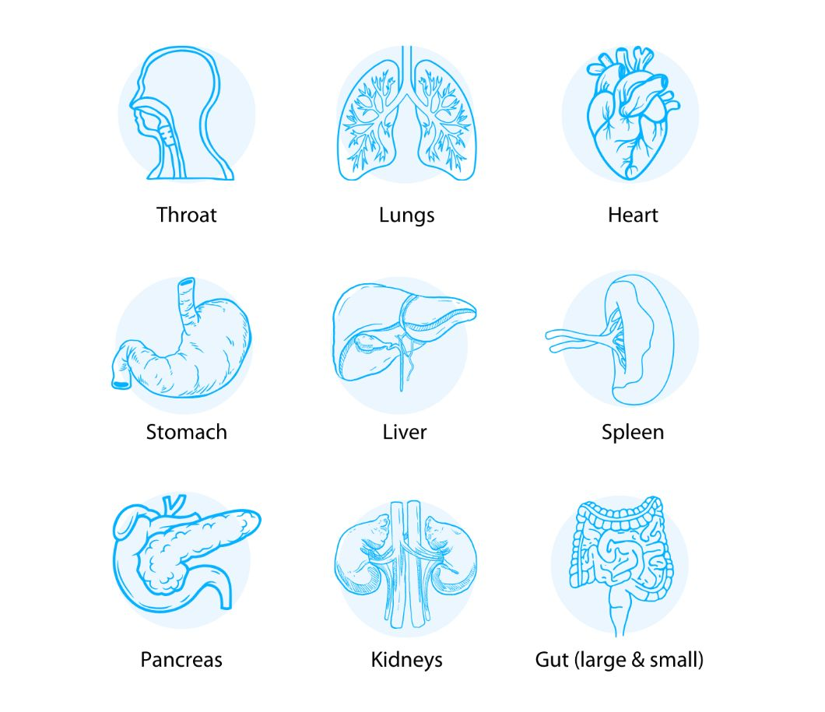
THE ULTIMATE PATH TO EMOTIONAL FREEDOM
Certified by and original © 2025 all rights reserved to vitalitylivingcollege.info.

Slide 44
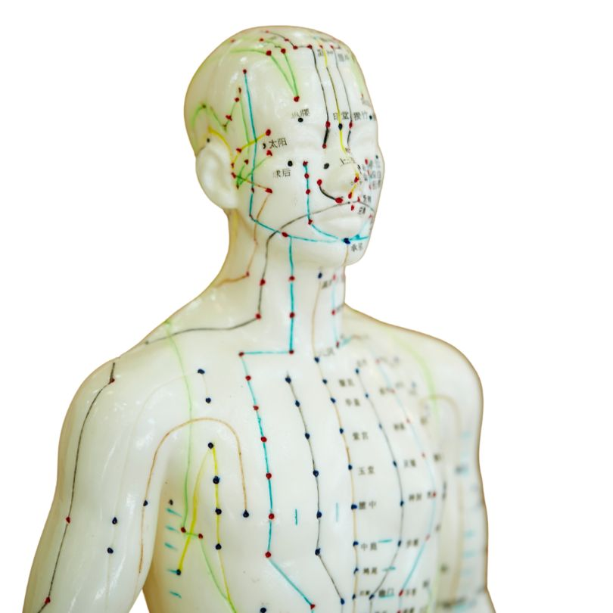
THE ULTIMATE PATH TO EMOTIONAL FREEDOM
Certified by and original © 2025 all rights reserved to vitalitylivingcollege.info.

Slide 45

TANTRUM RELEASE
FOR NEGATIVITY
Certified by and original © 2025 all rights reserved to vitalitylivingcollege.info.
Notes:
TANTRUM RELEASE FOR NEGATIVITY
WhyFrame:Didyouknowangerhasbeenlinkedtocancer,diseaseorillness?Whatif youcouldlearnaquickmethodthatyoucouldusetoletgoofanger?Ifyouwantedto vomitwouldletitoutorswallowitdown?Yes,betteroutthanin.Thismethodis taught inassemblies inschools, toVice Presidents inorganisations, and people who wanttohavebetterhealthandwellness.Optional:Story.
WhatandHowFrame
Bringintoyourawarenessanythingyouarefrustrated,annoyedorirritatedabout.
Placethefingersjustunderthecollarboneandgentlytap.
Takeabreathinandoutandmakealoud ‘Ahhh’soundasiflettingoutallnegativity.
Stampyourfeetvigorouslyasifhavingatantrum.
WhatandHowFrame
Bringintoyourawarenessanythingyouarefrustrated,annoyedorirritatedabout.
Optional:Youcanevenmeasureitonascaleof1to10,where10isforexamplereallyfrustratedand1isnotfrustratedatall.Go aheadandwriteyournumberinchat/whisperitoutloud.Youcanevenwritedowninchat/shoutoutloudwhatyouarefrustrated orannoyedabout.
Placethefingersjustunderthecollarboneandgentlytap.
Optional: The reason to touch this point is that the kidney meridians are located here, and kidneys are known to be linked to fear which can be underneath the surface of anger or frustration.
WhatandHowFrame
Takeabreathinandoutandmakealoud ‘Ahhh’soundasiflettingoutallnegativity.
Optional: The reason to make a loud ‘Ahhh’ sound is that the sounds you make are linked to the nervous and linguistic system and negativity will have a certain tone and energy and by voicing a sound that represents frustration or negativity it allows you to release the negativity much faster from the body.
Stampyourfeetvigorouslyasifhavingatantrum.
Optional: The reason to stamp the feet on the ground as if you are having a tantrum is as a child you might have been conditioned that it was not safe to express your emotions. Having a tantrum allows you to let go of any emotions and not bottle them
Whatif?:Goaheadandtakeabreathinandoutandnoticetheanger,frustration,irritation,or negativitynow.Whatnumberwouldyougiveitnowonascaleof1to10,where10isreallyhigh and1isnothighatall?Isitbetterthanbefore,worsethanbeforeorthesameasbefore? Go
aheadandwriteinchatwhatnumberitisatnow/raiseyourhandnowifitisbetterthanbefore, worsethanbeforeorthesameasbefore.Thereasonitgetsbetterisbecauseyouhavereleased
thenegativity.Thereasonitgetsworseisbecausesomethingiscomingupforfreedom.Thereason itstaysthesameisbecauseyouneedtotuneintowhatisgoingonforyouevenmore.
Summary
Why?Anger,frustration,irritation,andnegativitybetteroutthanin.
What?Underthecollarbonetapping,makinganahhsound,stampingthefeet.
How?Showandfollowalong.
Whatif?Feedback.Thereasonitgoesdown,staysthesame,andgetsworse.

Slide 46

STRESS RELEASE
Certified by and original © 2025 all rights reserved to vitalitylivingcollege.info.
Notes:
STRESS RELEASE
What is it for
The purpose of this stress release exercise is to provide a physical and mental outlet for releasing accumulated stress and tension. It aims to create a symbolic and intentional process of letting go, allowing individuals to experience a sense of relief.
How does it work
It aims to create a symbolic and intentional process of letting go, allowing individuals to experience a sense of relief and manageable. The act of tightening the hands into a fist physically engages the body, providing a tangible representation of holding onto stress.
Steps
1.⁠ ⁠Choose whether you want to stand or sit, whichever feels more comfortable for you. Ensure you're in a relaxed position with your feet firmly on the ground if you're sitting.
2.⁠ ⁠Close your eyes and imagine that the stress and tension in your life are now concentrated in your hands. Picture it as a ball of stress that you're holding onto.
3.⁠ ⁠Now, physically tighten your hands as if you are gripping onto that ball of stress. Make a fist and feel the tension in your fingers, palms, and wrists. Imagine transferring all the stress into this tight grip.
4.⁠ ⁠Slowly lower your hands down to your sides while maintaining a tight grip. This downward movement symbolises the act of letting go and releasing stress from your body.
5.⁠ ⁠Continue the motion by bringing your hands from your sides, moving them over your body, and then up towards the sky. The upward movement signifies releasing the stress and letting it go.
6.⁠ ⁠As you move your hands over and up, make your hands tight, tight, tight, tight, tight to reinforce the idea of squeezing out the stress. Feel the tension leaving your body with each repetition
7.⁠ ⁠At the peak of the upward movement, imagine a "whoosh" sound as if the stress is being energetically expelled from your hands and dissipating into the air.
8.⁠ ⁠After the "whoosh," slowly bring your hands back down to a relaxed position. Take a deep breath and feel the lightness, as if you've let go of the burden of stress. Embrace the sense of calm and relaxation.
9.⁠ ⁠Repeat this exercise as needed, and each time you go through the motions, focus on the act of releasing and freeing yourself from stress.
Benefits
This exercise is effective for releasing all that negativity, including tension in your gut or the pit of your stomach, anxiety, and stress.

Slide 47

TRIPLE POINT
CALMER
Certified by and original © 2025 all rights reserved to vitalitylivingcollege.info.
Notes:
TRIPLE POINT CALMER
What is it for
It is a tapping exercise which can help in calming sudden emotional outbursts and abreactions.
This exercise focuses on three points:
•⁠ ⁠Under the eye (stomach meridian): Targets feelings of upsetness and emotional distress.
•⁠ ⁠Under the collarbone: May help release grief and related emotions (lungs meridian) while also considering the connection to the kidneys (filtration of toxins and emotional well-being).
•⁠ ⁠Under the arm (spleen meridian): Targets feelings of high alertness and anxiety. The spleen is linked to the adrenals, which regulate stress hormones.
Steps
1.⁠ ⁠Notice the emotion you want to calm down, like anger or sadness.
2.⁠ ⁠While tapping gently, repeat positive affirmations about feeling that way. For example, "Even though I'm feeling (emotion), I deeply and completely accept myself."
3.⁠ ⁠Tap under your eye a few times.
4.⁠ ⁠Tap under your collarbone a few times.
5.⁠ ⁠Tap under your arm a few times.
6.⁠ ⁠Keep tapping on these points while thinking about letting go of the emotion until you feel calmer.
Benefits
It can help you quickly manage sudden emotional distress, offering a self-help tool to calm sadness, anger, or anxiety.

Slide 48
THE ULTIMATE PATH TO EMOTIONAL FREEDOM
2
Learn a clinical proven method to emotionally regulate and lay the foundation for
wellness versus illness.
Certified by and original © 2025 all rights reserved to vitalitylivingcollege.info.

Slide 49


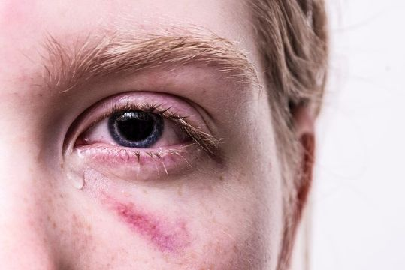

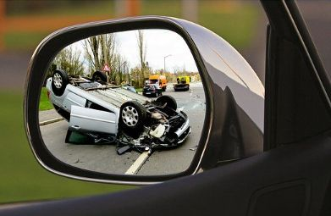
THE ULTIMATE PATH TO EMOTIONAL FREEDOM
EMOTIONAL FREEDOM TECHNIQUES (EFT)
Overcome stress
Lower physicalpain
Heal the past
Defeat phobias
Freedom from trauma
Emotional regulation
Stop cravings
Break through limits
Certified by and original © 2025 all rights reserved to vitalitylivingcollege.info.

Slide 50

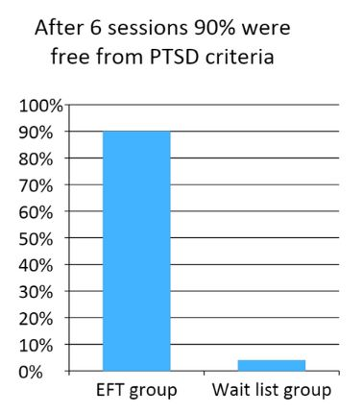
FAST AND LONG-LASTING DROP IN PTSD* (POST TRAUMA STRESS)
Certified by and original © 2025 all rights reserved to vitalitylivingcollege.info.
https://oce.ovid.com/article/00005053-201302000-00014/HTML

Slide 51

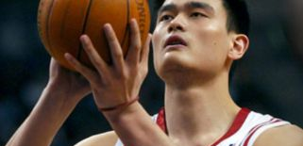
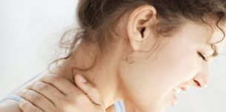

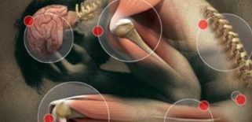

REDUCTION IN PAIN AND IMPROVEMENT IN PERFORMANCE
Reduction in test anxiety
Athletic performance improves by 26%
Decrease in pain, distress, and cravings
Depression reduces by 73%
Less pain with fibromyalgia
Reduction of phobias and fears
Church, D., Stapleton, P., Vasudevan, A., & O'Keefe, T. (2022) Frontiers in psychology,
Certified by and original © 2025 all rights reserved to vitalitylivingcollege.info.

Slide 52
MARKERS OF ILL-HEALTH LOWER AND HEALTH INCREASES
8%
31%
113%
HAPPINESS
BLOOD PRESSURE
IMMUNE SYSTEM
74%
32%
37%
35%
40%
57%
FOOD CRAVINGS
PTSD
CORTISOL
DEPRESSION
ANXIETY
PAIN
Bach, D., Groesbeck, G., Stapleton, P., Sims, R., Blickheuser, K., & Church, D. (2019) Journal of evidence-based integrative medicine
Certified by and original © 2025 all rights reserved to vitalitylivingcollege.info.

Slide 53

IMMUNE BOOSTING – THYMUS TAPPING
Certified by and original © 2025 all rights reserved to vitalitylivingcollege.info.
Notes:
Make a gentle fist with the hand.
Find the thymus point of your breastbone.
Gently thump while making an ‘Ahhh’ sound.
The sound reverberates as if you are getting a head massage or like Tarzan.

Slide 54

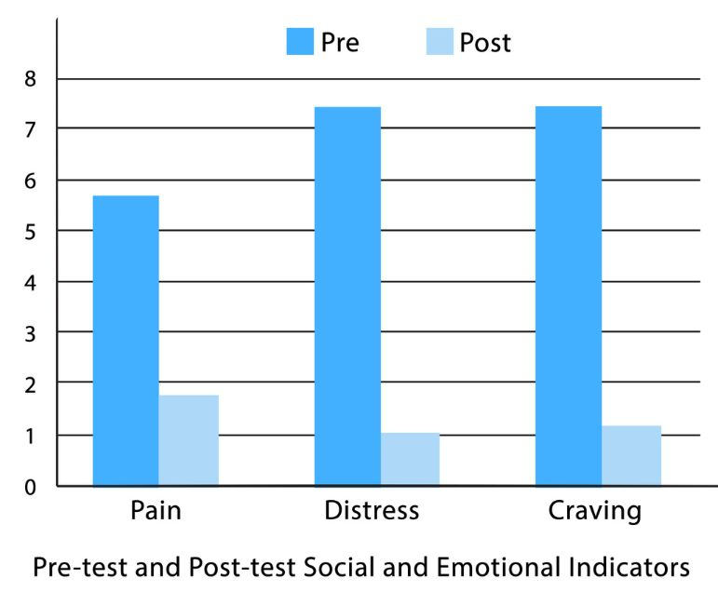

BURNOUT IN 217 HEALTHCARE WORKERS IMPROVES BY 45%
Before EFT
After EFT
Certified by and original © 2025 all rights reserved to vitalitylivingcollege.info.

Slide 55
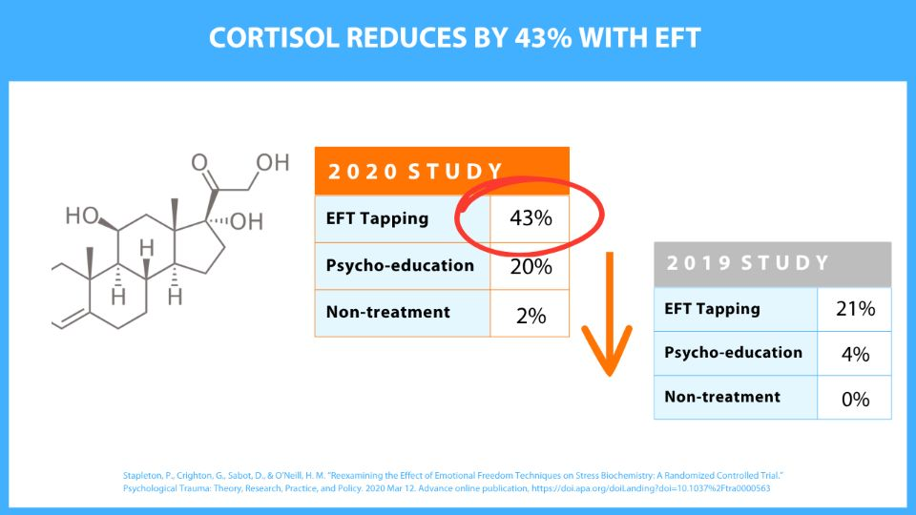

Slide 56
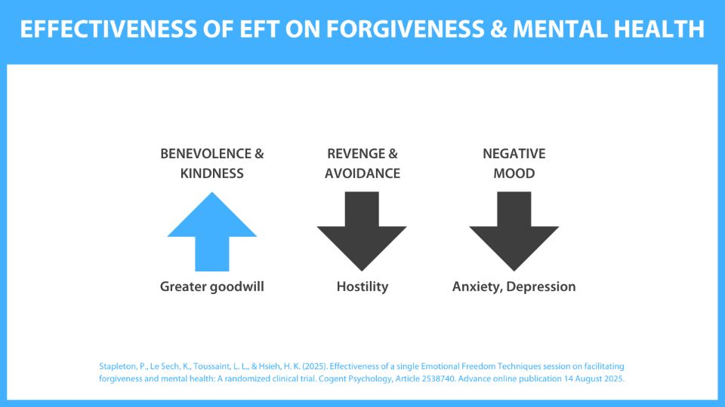

Slide 57
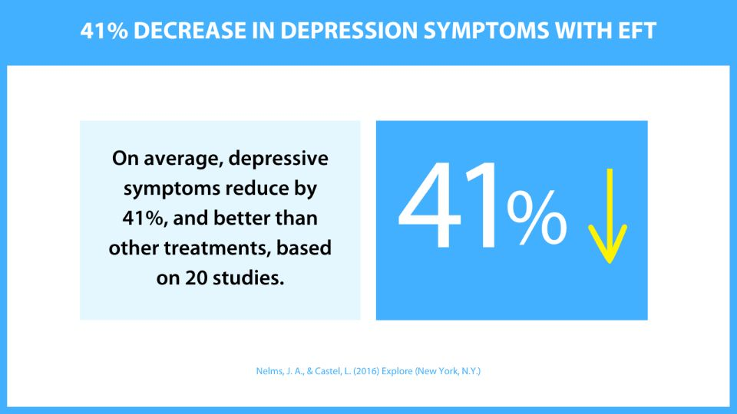

Slide 58
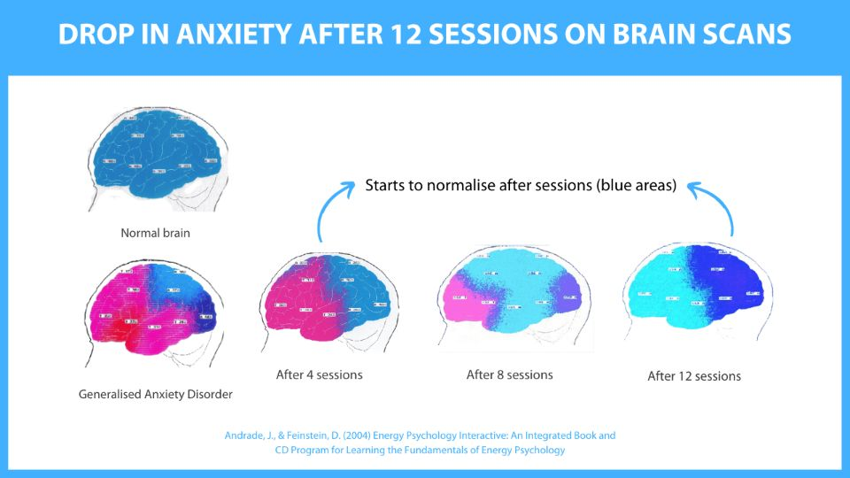

Slide 59
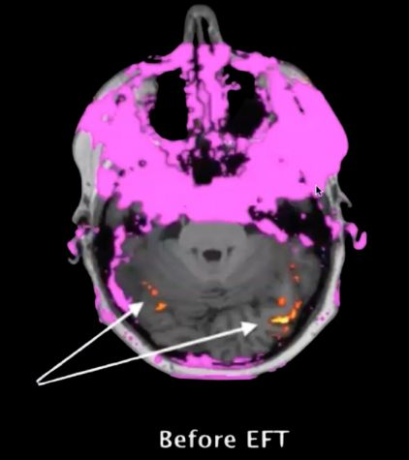
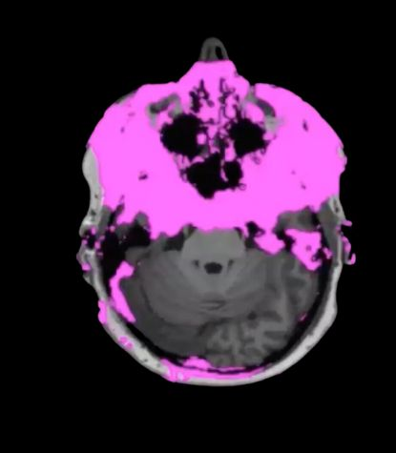

REDUCTION IN ADDICTIONS AND CRAVINGS
Brain does not signal for a craving.
Brain signals the body for an additive craving.
BEFORE EFT
AFTER 4 WEEKS EFT
Certified by and original © 2025 all rights reserved to vitalitylivingcollege.info.
Stapleton, P., Buchan, C., Mitchell, I., McGrath, Y., Gorton, P., & Carter, B. (2019) Integrative and Complementary Medicine

Slide 60
STEADY AND LONG-LASTING WEIGHT LOSS
WEIGHT
5.05 kg
4 WEEK TRIAL
6 MONTHS
12 MONTHS
TIME
Certified by and original © 2025 all rights reserved to vitalitylivingcollege.info.

Slide 61

FREE YOURSELF FROM STRESS AND FIND CALM
THE 7 STEPS OF EFT
Identify the issue or goal
Get a measure for it
Start EFT Tapping on the side of the hand
Tap on the upper body, facial and finger points
Close sequence
Relax
Testing
Certified by and original © 2025 all rights reserved to vitalitylivingcollege.info.

Slide 62

THE ULTIMATE PATH TO EMOTIONAL FREEDOM
1. IDENTIFY GOAL OR ISSUE
What do you want?
What issue do you want to solve?
How does it make you feel?
Certified by and original © 2025 all rights reserved to vitalitylivingcollege.info.

Slide 63
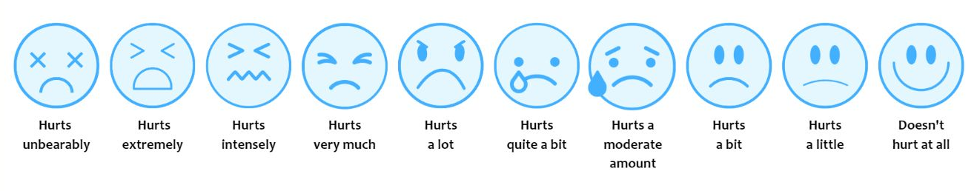
THE ULTIMATE PATH TO EMOTIONAL FREEDOM
2. GET A MEASURE FOR IT
On a scale of 1 to 10, what number would you give the issue (where 10 is uncomfortable or 1 is not uncomfortable at all).
Certified by and original © 2025 all rights reserved to vitalitylivingcollege.info.

Slide 64
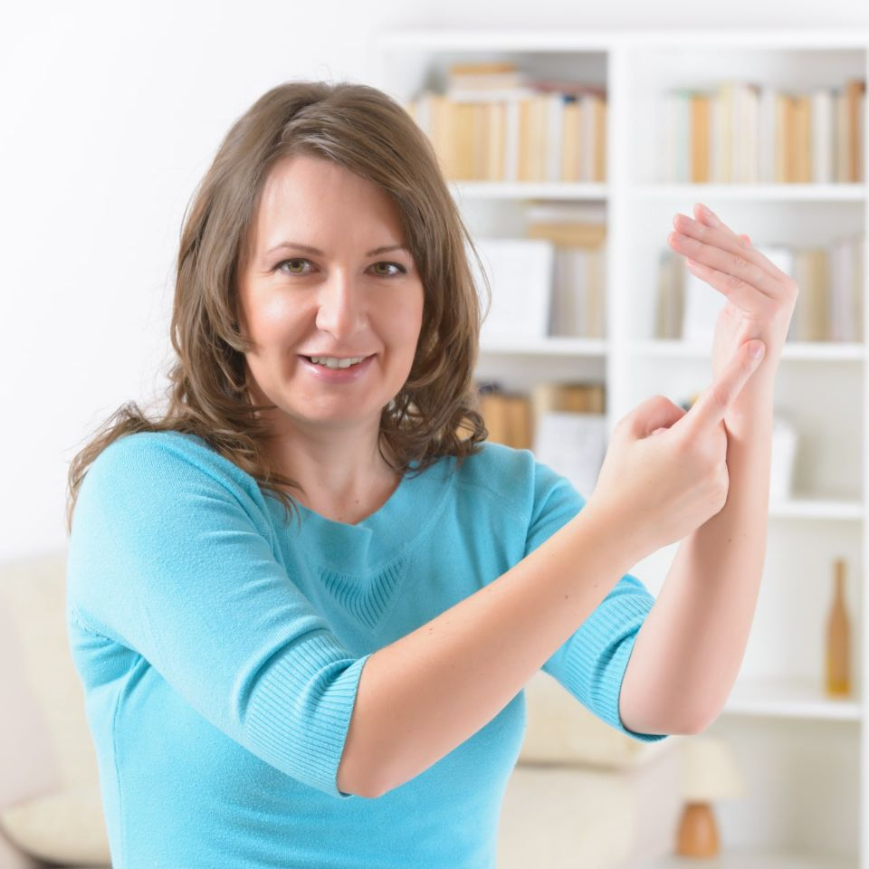
THE ULTIMATE PATH TO EMOTIONAL FREEDOM
3. START TAPPING ON THE SIDE OF THE HAND
Tap on the side of the hand
Use the phrase, “Even though I have [THIS PROBLEM], I deeply and completely love and accept myself.”
Repeat 3 times
Certified by and original © 2025 all rights reserved to vitalitylivingcollege.info.

Slide 65
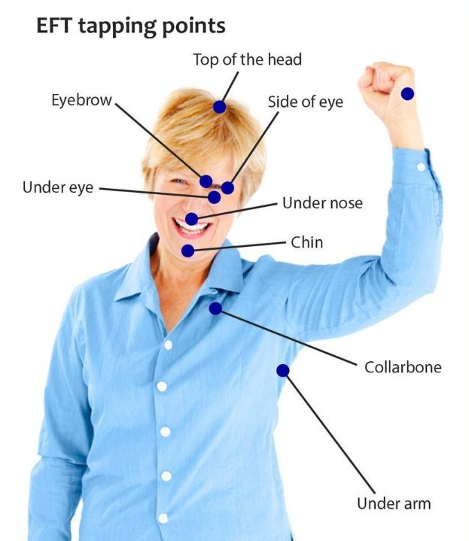
THE ULTIMATE PATH TO EMOTIONAL FREEDOM
4. TAP ON THE UPPER BODY, FACIAL AND FINGER POINTS
Then tap on the upper body and finger points.
While saying the words from the problem “out loud”.
Certified by and original © 2025 all rights reserved to vitalitylivingcollege.info.

Slide 66
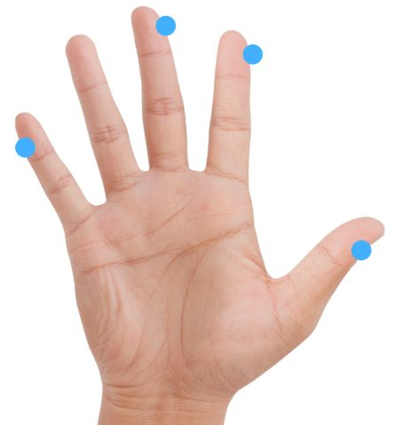
THE ULTIMATE PATH TO EMOTIONAL FREEDOM
4. TAP ON THE UPPER BODY, FACIAL AND FINGER POINTS
Then tap on the finger points:
  Thumb
  Index
  Middle
  Little
Certified by and original © 2025 all rights reserved to vitalitylivingcollege.info.

Slide 67
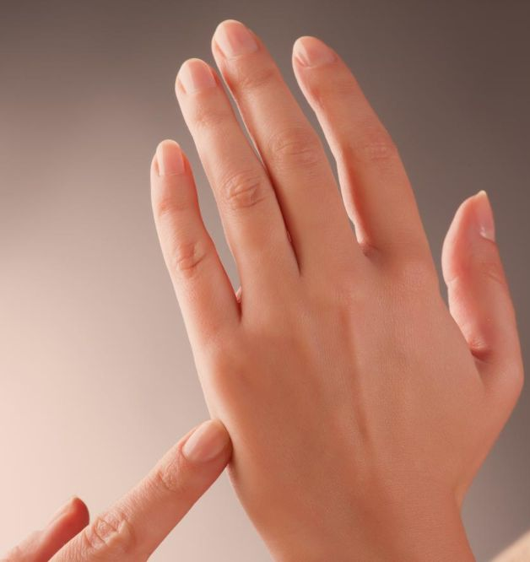
THE ULTIMATE PATH TO EMOTIONAL FREEDOM
5. CLOSE ON THE SEQUENCE
Come back to the side of the hand, also known as the karate chop point, and say the starting phrase out loud again.
“Even though I have [THIS PROBLEM], I deeply and completely love and accept myself.”
Certified by and original © 2025 all rights reserved to vitalitylivingcollege.info.

Slide 68

THE ULTIMATE PATH TO EMOTIONAL FREEDOM
6. RELAX
Breathe.
Take a sip of water.
Reflect on how you are feeling.
Certified by and original © 2025 all rights reserved to vitalitylivingcollege.info.

Slide 69

THE ULTIMATE PATH TO EMOTIONAL FREEDOM
7. TESTING
How are you feeling?
What happened?
Say "Great" if the response is:
  Worse
  The same
  Better
Certified by and original © 2025 all rights reserved to vitalitylivingcollege.info.

Slide 70
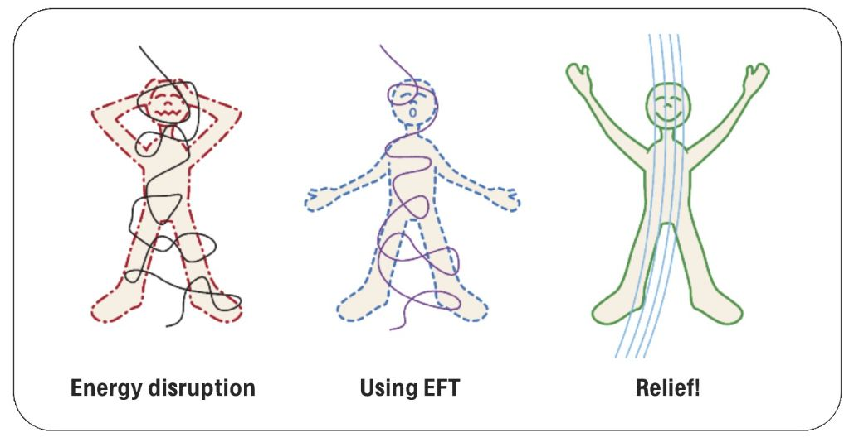
THE ULTIMATE PATH TO EMOTIONAL FREEDOM
Certified by and original © 2025 all rights reserved to vitalitylivingcollege.info.

Slide 71
THE ULTIMATE PATH TO EMOTIONAL FREEDOM
3
Balance your breathing using
Emotional Freedom Techniques (EFT)
Certified by and original © 2025 all rights reserved to vitalitylivingcollege.info.

Slide 72

THE ULTIMATE PATH TO EMOTIONAL FREEDOM
IMPORTANCE OF BREATHING
Oxygen supply
  Provides oxygen for cellular respiration in mitochondria
  Enables production of ATP, the body’s energy source
  Without oxygen → cell failure and death
Carbon dioxide removal
  Eliminates CO₂, a waste product of metabolism
  Prevents CO₂ buildup that disrupts blood pH
  Essential for acid-base balance
Maintaining homeostasis
  Regulates blood pH by controlling CO₂ levels
  Helps with temperature regulation through heat loss in exhalation
Certified by and original © 2025 all rights reserved to vitalitylivingcollege.info.
Notes:
Breathing is one of the most vital functions of the human body. It keeps us alive and influences both our physical and mental well-being.
Provides Oxygen:
Every cell in the body needs oxygen to produce energy. Breathing brings oxygen into the lungs, where it enters the bloodstream and is carried to all body parts to support essential functions.
Removes Carbon Dioxide:
Breathing out expels carbon dioxide, a waste product of metabolism. This prevents toxic buildup in the body and maintains healthy blood composition.
Maintains pH Balance:
The respiratory system helps regulate the pH level of the blood. Too much carbon dioxide can make the blood acidic, so proper breathing keeps this balance stable.
Supports Brain Function:
The brain uses about 20% of the body’s oxygen supply. Adequate breathing ensures proper oxygen flow to the brain, improving concentration, memory, and decision-making.
Regulates Heart Rate and Stress:
Slow, deep breathing activates the parasympathetic nervous system, which calms the body, reduces heart rate, and lowers stress levels.
Improves Focus and Emotional Stability:
Controlled breathing enhances mental clarity, reduces anxiety, and helps manage emotions by increasing oxygen supply and promoting relaxation.
Enhances Physical Performance:
Efficient breathing techniques help athletes and individuals sustain energy levels, improve endurance, and recover faster.

Slide 73
THE ULTIMATE PATH TO EMOTIONAL FREEDOM
IMPORTANCE OF BREATHING
Supporting other systems
  Works with the circulatory system to deliver O₂ & remove CO₂
  Critical for brain function—oxygen levels affect mood & cognition
Immune function
  Respiratory tract filters pathogens via mucus & cilia
  First line of defense against airborne infections
Metabolic processes
  Ensures tissues receive oxygen needed for nutrient metabolism
Exercise & physical activity
  Increased breathing meets higher oxygen demand
  Proper breathing improves performance and endurance
Certified by and original © 2025 all rights reserved to vitalitylivingcollege.info.
Notes:
Breathing is one of the most vital functions of the human body. It keeps us alive and influences both our physical and mental well-being.
Provides Oxygen:
Every cell in the body needs oxygen to produce energy. Breathing brings oxygen into the lungs, where it enters the bloodstream and is carried to all body parts to support essential functions.
Removes Carbon Dioxide:
Breathing out expels carbon dioxide, a waste product of metabolism. This prevents toxic buildup in the body and maintains healthy blood composition.
Maintains pH Balance:
The respiratory system helps regulate the pH level of the blood. Too much carbon dioxide can make the blood acidic, so proper breathing keeps this balance stable.
Supports Brain Function:
The brain uses about 20% of the body’s oxygen supply. Adequate breathing ensures proper oxygen flow to the brain, improving concentration, memory, and decision-making.
Regulates Heart Rate and Stress:
Slow, deep breathing activates the parasympathetic nervous system, which calms the body, reduces heart rate, and lowers stress levels.
Improves Focus and Emotional Stability:
Controlled breathing enhances mental clarity, reduces anxiety, and helps manage emotions by increasing oxygen supply and promoting relaxation.
Enhances Physical Performance:
Efficient breathing techniques help athletes and individuals sustain energy levels, improve endurance, and recover faster.

Slide 74
THE ULTIMATE PATH TO EMOTIONAL FREEDOM
CONNECTION BETWEEN BREATHING & EMOTIONS
Emotion | Breathing Pattern | Body Response | Effects
Stress/Anxiety | Rapid, shallow | Sympathetic activation | Dizziness, tension
Fear | Quick, shallow | Threat response | Ready for action
Anger | Rapid, forceful | Strong arousal | Heightened tension
Sadness | Slow, sighing | Low energy | Tension release
Calm | Slow, deep | Parasympathetic | Relaxation
Happiness/Excitement | Deep, steady | Balanced activation | Engagement, vitality
Certified by and original © 2025 all rights reserved to vitalitylivingcollege.info.
Notes:
Breathing patterns are closely linked to our emotional states. Different emotions can induce specific changes in the way we breathe. Understanding these patterns can help in recognising and managing emotions effectively. Here’s a detailed look at the relationship between emotions and breathing: 1. Stress and anxiety Breathing pattern: Rapid, shallow breaths (hyperventilation). Physiological response: When stressed or anxious, the body's sympathetic nervous system is activated, preparing for a “fight or flight” response. This increases breathing rate and reduces the depth of breaths to quickly intake more oxygen. Effects: Hyperventilation can lead to dizziness, increased heart rate, and a sense of breathlessness, which can exacerbate feelings of anxiety and panic. 2. Fear Breathing pattern: Quick, shallow breaths. Physiological response: Similar to anxiety, fear activates the sympathetic nervous system. The body prepares to respond to a threat, increasing the rate of respiration. Effects: Rapid breathing increases oxygen intake, preparing muscles for quick action. 3. Anger Breathing pattern: Rapid and forceful breaths. Physiological response: Anger triggers the “fight or flight” response, leading to an increase in breathing rate and intensity. Effects: This type of breathing can heighten physical tension and emotional arousal. 4. Sadness Breathing pattern: Slow, sighing breaths. Physiological response: Sadness often leads to a reduction in overall activity and energy levels, causing slower and deeper breaths. Effects: Sighing is a common respiratory response to sadness, helping to release tension and emotional weight. 5. Calmness and relaxation Breathing pattern: Slow, deep, and rhythmic breaths. Physiological response: Activation of the parasympathetic nervous system, which promotes a “rest and digest” state. This slows the heart rate and promotes relaxation. Effects: Deep breathing enhances relaxation, reduces stress hormone levels, and promotes a sense of well-being. 6. Happiness and excitement Breathing pattern: Deep, steady, and sometimes slightly faster breaths. Physiological response: Positive emotions can lead to a balanced activation of both the sympathetic and parasympathetic nervous systems, promoting a sense of vitality and readiness. Effects: This breathing pattern supports feelings of enthusiasm and engagement.

Slide 75

Certified by and original © 2025 all rights reserved to vitalitylivingcollege.info.
RELAXED BREATHING WITH EFT TAPPING
Notes:
Make a gentle fist with the hand.
Find the thymus point of your breastbone.
Gently thump while making an ‘Ahhh’ sound.
The sound reverberates as if you are getting a head massage or like Tarzan.

Slide 76
FREE YOURSELF FROM STRESS AND FIND CALM
4
Uncover the root cause of your
stress to find ultimate calm.
Certified by and original © 2025 all rights reserved to vitalitylivingcollege.info.

Slide 77
THE ULTIMATE PATH TO EMOTIONAL FREEDOM
SURFACE SYMPTOMS VERSUS THE ROOT CAUSE
Surface
Symptoms
Deeper Root Cause
Certified by and original © 2025 all rights reserved to vitalitylivingcollege.info.

Slide 78
THE ULTIMATE PATH TO EMOTIONAL FREEDOM
SURFACE SYMPTOMS VERSUS THE ROOT CAUSE
Surface
Symptoms
Deeper Root Cause
Emotions
Past memories
Beliefs
Certified by and original © 2025 all rights reserved to vitalitylivingcollege.info.

Slide 79
THE ULTIMATE PATH TO EMOTIONAL FREEDOM
Surface
Symptoms
Deeper Root Cause
Daily Headaches
Helpless
Must Not Feel Helpless
Cannot Say No
Dad’s Approval
Must Prove Myself
Certified by and original © 2025 all rights reserved to vitalitylivingcollege.info.

Slide 80
THE ULTIMATE PATH TO EMOTIONAL FREEDOM
SURFACE SYMPTOMS VERSUS THE ROOT CAUSE
Surface
Symptoms
Deeper Root Cause
Stress
Anxiety
Overthinking
Procrastination
Phobias
Low esteem
Health challenges
Relationship fights
Sleep issues
Money blocks
Career challenges
Certified by and original © 2025 all rights reserved to vitalitylivingcollege.info.

Slide 81
THE ULTIMATE PATH TO EMOTIONAL FREEDOM
SURFACE SYMPTOMS VERSUS THE ROOT CAUSE
Surface
Symptoms
Deeper Root Cause
Emotions
Past memories
Beliefs
Certified by and original © 2025 all rights reserved to vitalitylivingcollege.info.

Slide 82
THE ULTIMATE PATH TO EMOTIONAL FREEDOM
Surface
Symptoms
Deeper Root Cause
Add your example
Add your own example
Certified by and original © 2025 all rights reserved to vitalitylivingcollege.info.

Slide 83
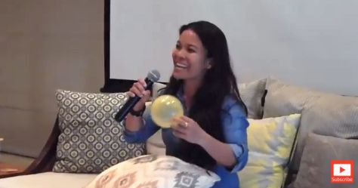
THE ULTIMATE PATH TO EMOTIONAL FREEDOM
FREEDOM FROM BALLOON PHOBIA
“I had a very bad fear of balloons. Because of the violence where I lived, every time a balloon would burst, I thought I would die. I’m not scared anymore. When there is a celebration with balloons, I’m going to say OK come over.”
Elsa Bulo, Trainer, Germany
Certified by and original © 2025 all rights reserved to vitalitylivingcollege.info.
Notes:
A front-facing picture with good lighting is best.

Slide 84

THE ULTIMATE PATH TO EMOTIONAL FREEDOM
SPUR PAIN RELEASED
“I had this severe spur pain which I’m now tapping on, and I’m not feeling the pain. I got to understand that it is me who doesn’t have to allow situations to take control over myself. That is the healing that I’ve felt."
Maria D’Souza, Teacher, India
Certified by and original © 2025 all rights reserved to vitalitylivingcollege.info.
Notes:
A front-facing picture with good lighting is best.

Slide 85
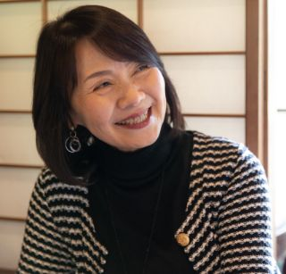
THE ULTIMATE PATH TO EMOTIONAL FREEDOM
TRANSFORMED MY RELATIONSHIP WITH STRESS
“Attending the Freedom Code was truly transformative for me; it changed my relationship with stress. The practical techniques and insights on stress that I acquired have empowered me to manage my stress and alleviate its impact on my health and relationships. I'm grateful for the journey and the positive impact it's had on my life.”
Karen, Executive, United States
Certified by and original © 2025 all rights reserved to vitalitylivingcollege.info.
Notes:
A front-facing picture with good lighting is best.

Slide 86
THE ULTIMATE PATH TO EMOTIONAL FREEDOM
SUMMARY OF PAST SITUATION TO NEW SITUATION
A front-facing picture
with good lighting
is best.
“Their quote in italics, pick the parts that relate to what the presentation is about. Make sure the spelling and grammar are correct and delete parts that do not relate. This must relate to your audience and begin with them and not about you. So, if the testimonial started with, [YOUR NAME] was fantastic, delete it. You can keep that for a later section, if needed.”
Name, Designation, City, Country
Certified by and original © 2025 all rights reserved to vitalitylivingcollege.info.

Slide 87
THE ULTIMATE PATH TO EMOTIONAL FREEDOM
Anxiety
Auto Accident
Boredom
Claustrophobia
Depression
Grief
Guilt
Headache
Insomnia
Limiting Beliefs
Love Pain
Physical Pain
Panic attack
Sadness
Shame
Stress
Self Image
Sexual Abuse
Sports Issues
Trauma
War memories
Weight Loss
      Phobias/Fears
      Public Speaking
      Dentist
      Rats
      Spiders
      Roaches
      Needles
      Driving
      Snakes
      Heights
      Water
Certified by and original © 2025 all rights reserved to vitalitylivingcollege.info.

Slide 88
THE ULTIMATE PATH TO EMOTIONAL FREEDOM
.. And that’s just to begin with…
I have completed over 4700 client sessions and
trained 43000 plus people, guiding them from stress to emotional balance and improved well-being.
Certified by and original © 2025 all rights reserved to vitalitylivingcollege.info.

Slide 89
THE ULTIMATE PATH TO EMOTIONAL FREEDOM
.. And that’s just to begin with…
I have worked with over 500 clients and trained 250 people, guiding them from stress to emotional balance and improved well-being.
Certified by and original © 2025 all rights reserved to vitalitylivingcollege.info.

Slide 90

You have 2 options now
Certified by and original © 2025 all rights reserved to vitalitylivingcollege.info.

Slide 91
THE ULTIMATE PATH TO EMOTIONAL FREEDOM
1. Do nothing
Certified by and original © 2025 all rights reserved to vitalitylivingcollege.info.

Slide 92
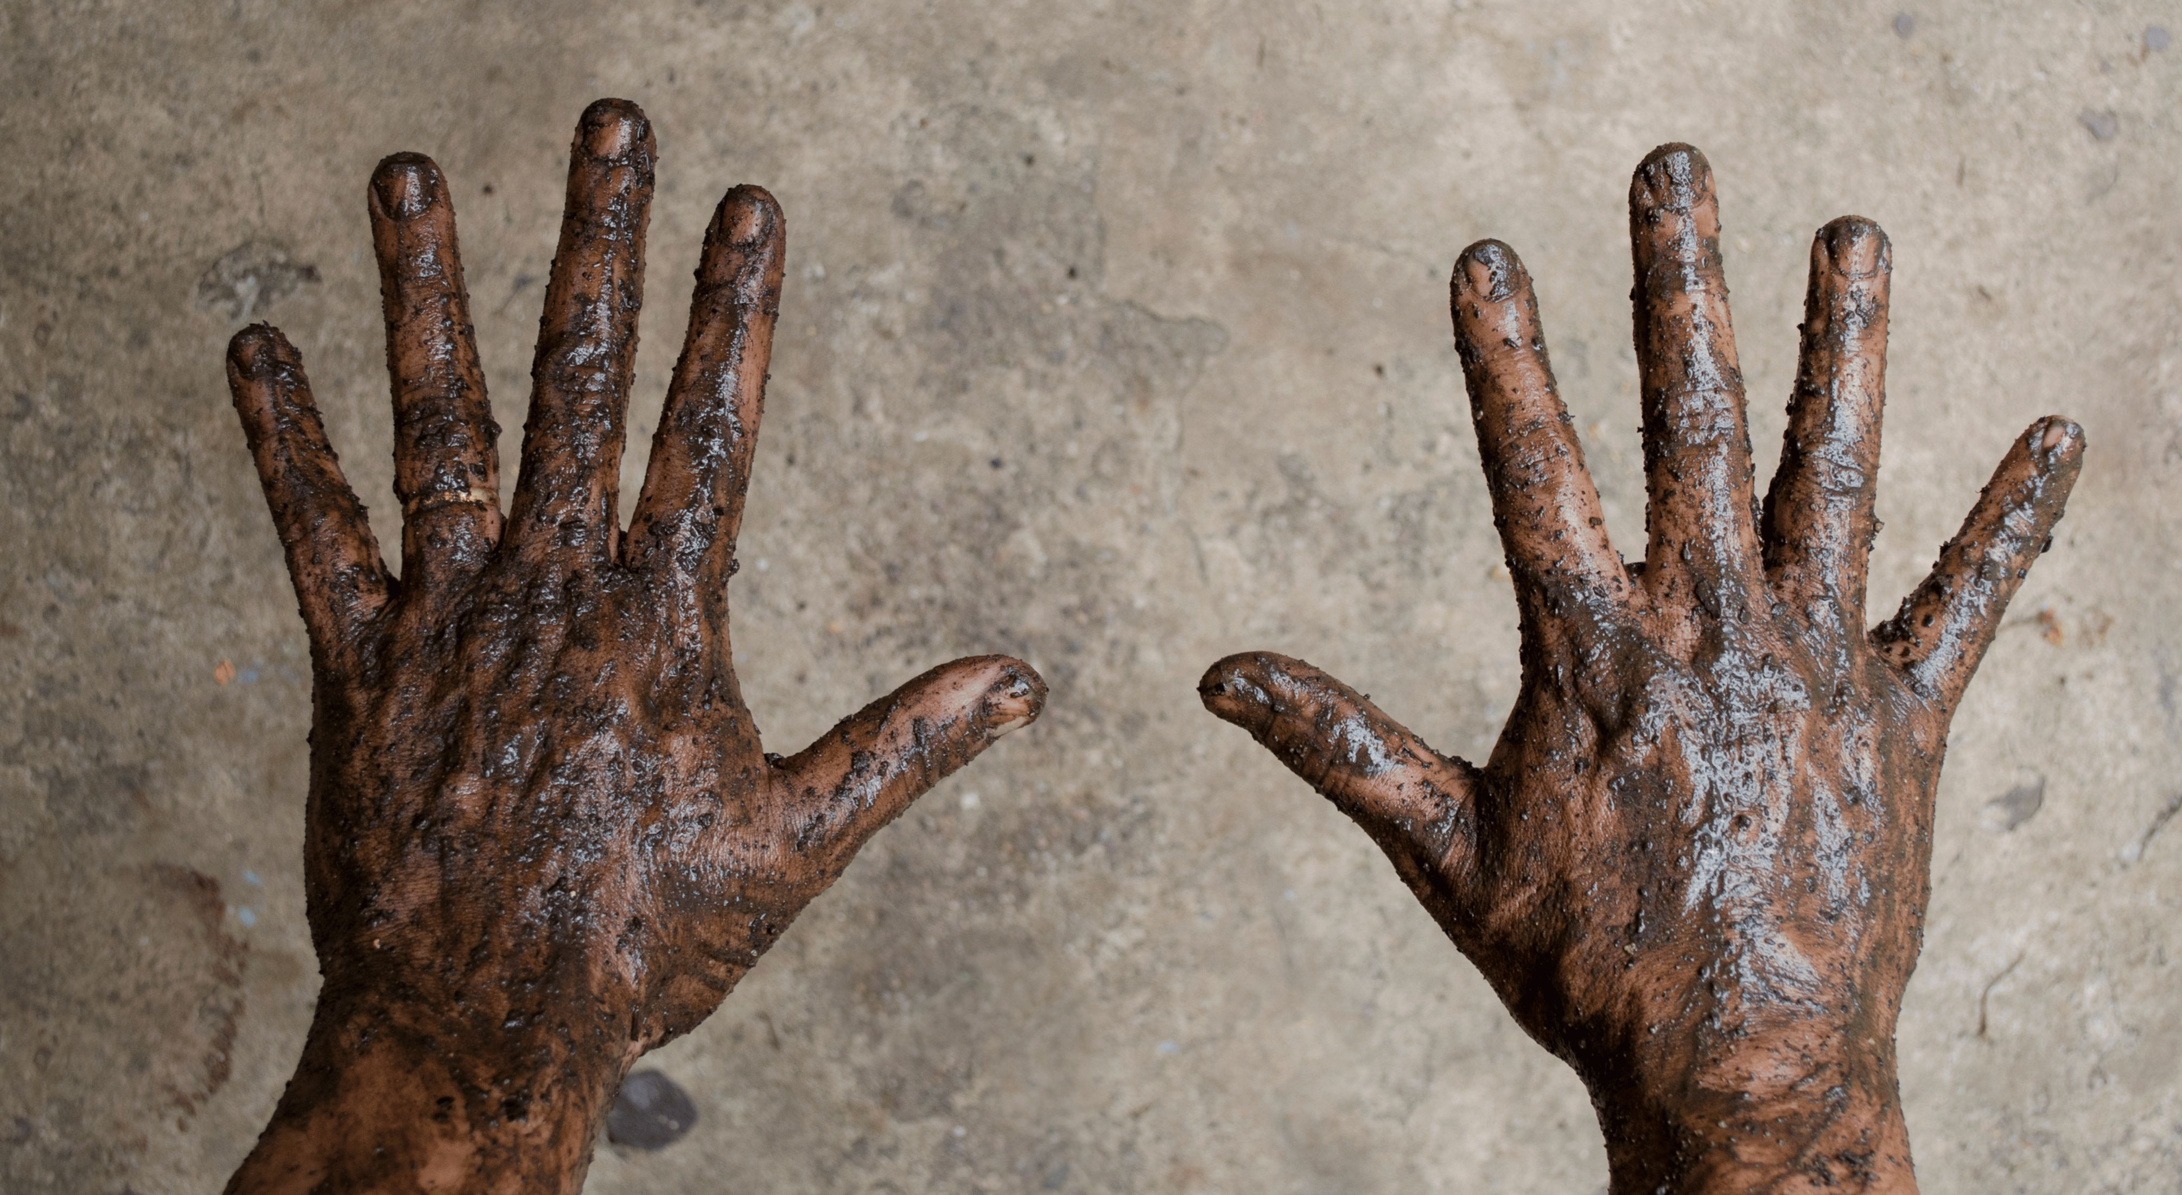
Certified by and original © 2025 all rights reserved to vitalitylivingcollege.info.
Notes:
This is the do-nothing option. Explain to them what might happen if they chose to do nothing. Ideally use a metaphor from your own story as this is much more soul-centered than making people feel scared.

Slide 93
THE ULTIMATE PATH TO EMOTIONAL FREEDOM
2. Free Yourself & Be Happy
Certified by and original © 2025 all rights reserved to vitalitylivingcollege.info.

Slide 94

Certified by and original © 2025 all rights reserved to vitalitylivingcollege.info.

Slide 95
THE ULTIMATE PATH TO EMOTIONAL FREEDOM
So, if this feels like you and you want to
learn how you can free yourself from stress
and really take charge of your life, your next step is
THE FREEDOM CODE
where you clear and explore the underlying causes
of your stress, how you can manage it, and lead a healthier, happier personal and professional life.
Certified by and original © 2025 all rights reserved to vitalitylivingcollege.info.
Notes:
This is now when you directly asking your audience that if they want to take the next step and move from their current situation to their desired situation. If yes, then you would love to have a complimentary coaching call with them.
The only caveat to this is when you are conducting the presentation one-to-one and the natural progression is about talking about your offer in their context. And if this is the case, begin by asking, “how do you feel?” to gauge where they are at? Then ask them what they want and how what you shared in the Discovery Presentation might help them. Let them convince you first that they are ready for the offer.

Slide 96
SO, WHAT'S THE FREEDOM CODE?
It’s a personal development and self-healing online / off-line program based on
5 TRANSFORMATIONAL PILLARS
that help you to feel healthier, happier,
more peaceful and calmer.
Certified by and original © 2025 all rights reserved to vitalitylivingcollege.info.

Slide 97



THE ULTIMATE PATH TO EMOTIONAL FREEDOM
THE 5 TRANSFORMATIONAL PILLARS
EMOTIONS
BREATHING
BODY
Emotional regulation for
vitality and wellness
Better breathing to reverse anxiety and condition calm
Relieve physical tension, stress and worry to feel relaxed and lighter
Certified by and original © 2025 all rights reserved to vitalitylivingcollege.info.
Notes:
Emotional regulation for vitality and wellness
Better breathing to reverse anxiety and condition calm
Relieve physical tension, stress and worry to feel relaxed and lighter
Let go of the past to lay the foundation for good health
Create empowering beliefs to move towards what you want in life

Slide 98

THE ULTIMATE PATH TO EMOTIONAL FREEDOM
THE 5 TRANSFORMATIONAL PILLARS
LETTING GO
BELIEFS
Let go of the past to lay the foundation for good health
Create empowering beliefs to move towards what you want in life
Certified by and original © 2025 all rights reserved to vitalitylivingcollege.info.
Notes:
Emotional regulation for vitality and wellness
Better breathing to reverse anxiety and condition calm
Relieve physical tension, stress and worry to feel relaxed and lighter
Let go of the past to lay the foundation for good health
Create empowering beliefs to move towards what you want in life

Slide 99
THE ULTIMATE PATH TO EMOTIONAL FREEDOM
WHAT WILL YOU LEARN:
Module 1: Relaxed Emotions — Feel to Heal
Module 2: Relaxed Breathing & Body — Anchor in Safety
Module 3: Stress Release & Relief — Reset the Inner Circuit
Module 4: Free the Past & Let Go — Healing the Emotional Roots
Module 5: From Limits to Possibilities — Reprogramming the Mind
Module 6: The Way Forward — Personal Peace
Certified by and original © 2025 all rights reserved to vitalitylivingcollege.info.
Notes:
Module 1: Relaxed Emotions — Feel to Heal
Theme: Emotional Awareness & Regulation
You’ll Learn:
How stress shows up as hidden emotions in the body.
The difference between emotional suppression and safe expression.
Energy Flow® for releasing daily overwhelm, irritability, and anxiety.
Practices to identify emotional triggers and bring the body back to calm.
The 7 Steps of EFT Tapping.
Outcome:
You begin to understand your emotions instead of being ruled by them.
Module 2: Relaxed Breathing & Body — Anchor in Safety
Theme: Release Tension
You’ll Learn:
The science of the stress response (fight, flight, freeze, or fawn).
EFT Tapping to use the breath to communicate safety to your nervous system.
Energy Flow® techniques such as finger-hold breathing and heart-hold breathing.
Outcome:
Your body learns to exhale again — literally and energetically.
🌊 Module 3: Stress Release & Relief — Reset the Inner Circuit
Theme: From Overload to Release
You’ll Learn:
How chronic stress builds up as energy blocks and emotional residue.
EFT and Energy Flow® sequences for instant calm and relaxation.
Pressure-point tapping and worry release to detox the stress response.
Guided reflection: Where am I still holding on?
Outcome:
Deep physical, emotional, and mental relaxation. You feel lighter and more energised.
🌸 Module 4: Free the Past & Let Go — Healing the Emotional Roots
Theme: Releasing Stored Stress & Old Stories
You’ll Learn:
How unresolved past experiences keep the body stuck in stress mode.
Gentle tapping for forgiveness, self-compassion, and closure.
Past-selves and cellular-release exercises to free emotional memory.
Energy Flow® for clearing stored emotions.
Outcome:
You stop reliving the past in your body and open to emotional peace.
🌈 Module 5: From Limits to Possibilities — Reprogramming the Mind
Theme: Belief & Thought Transformation
You’ll Learn:
How limiting thoughts amplify stress and block ease.
EFT techniques for releasing limiting beliefs (“I can’t relax”, “I must be perfect”).
Reframing stress as feedback — not failure.
Mind-body tapping to create supportive inner beliefs.
Outcome:
You start choosing calm, confidence, and possibility over pressure and perfection.
🌞 Module 6: The Way Forward — Personal Peace
Theme: Integration, Self-Trust & Daily Practice
You’ll Learn:
How to create your personal Stress Freedom Toolkit.
Designing a daily routine of five-minute practices for ongoing emotional hygiene.
Anchoring peace and presence through the day — morning, midday, and night.
Commitment ritual: stepping into the New Freedom Model.
Outcome:
Stress no longer controls you — you live with emotional freedom, balance, and flow.

Slide 100
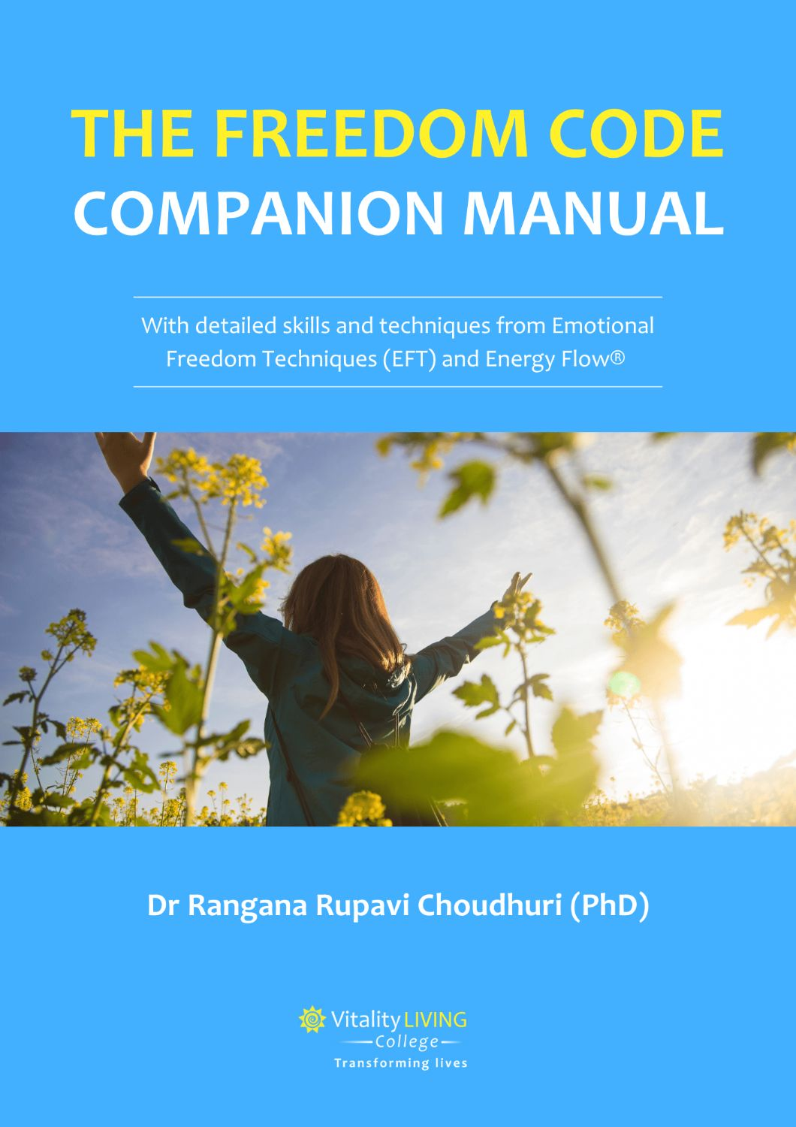
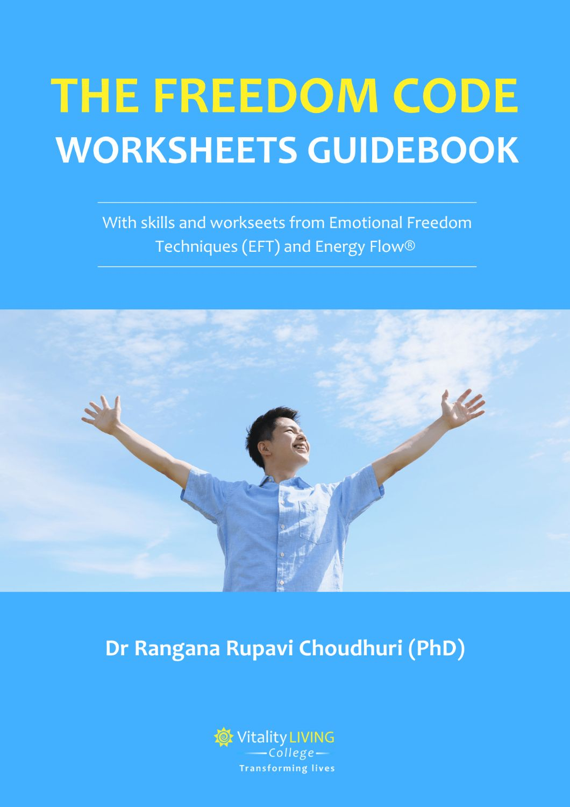
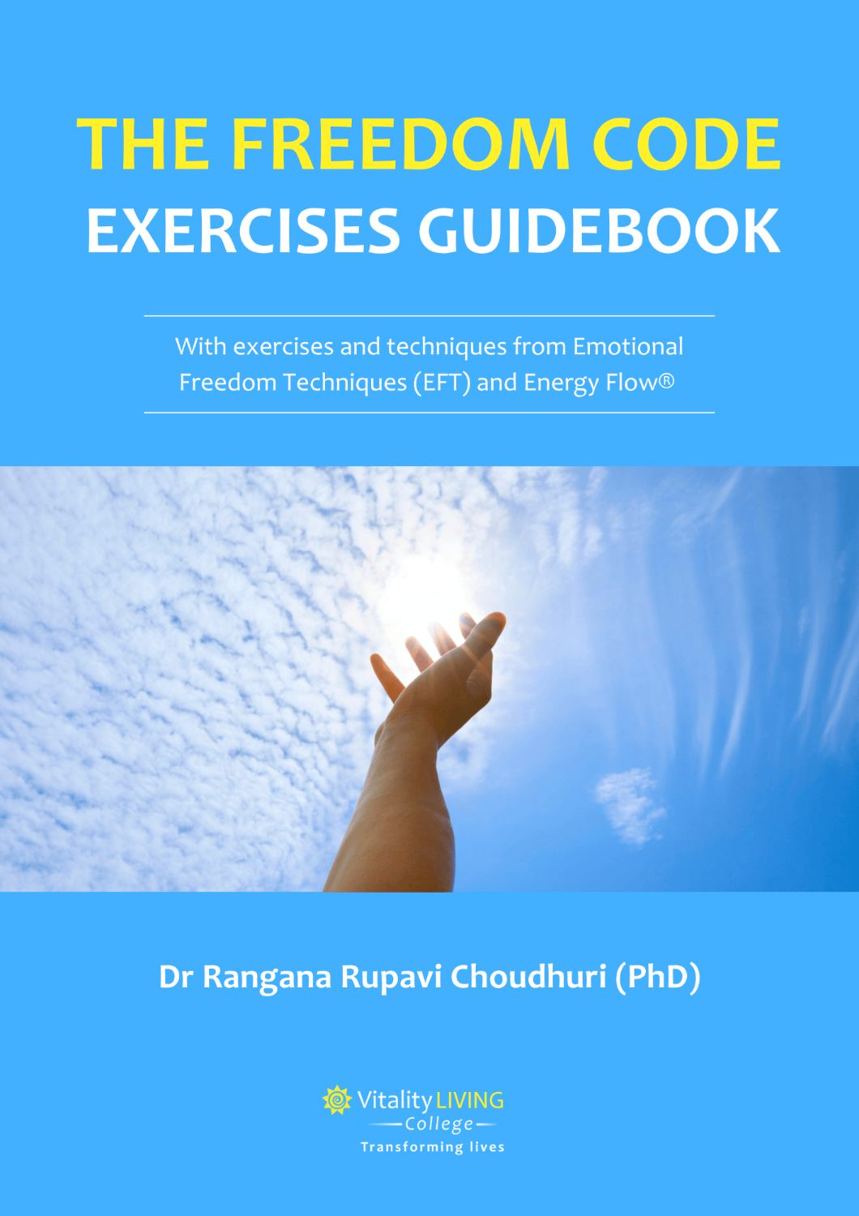
THE ULTIMATE PATH TO EMOTIONAL FREEDOM
WHAT WILL YOU LEARN:
Certified by and original © 2025 all rights reserved to vitalitylivingcollege.info.

Slide 101
THE ULTIMATE PATH TO EMOTIONAL FREEDOM
Your next step is to book
a complimentary consultation call with
myself and explore what you want and
how I can support you to get it.
Certified by and original © 2025 all rights reserved to vitalitylivingcollege.info.
Notes:
This is now when you directly asking your audience that if they want to take the next step and move from their current situation to their desired situation. If yes, then you would love to have a complimentary coaching call with them.
The only caveat to this is when you are conducting the presentation one-to-one and the natural progression is about talking about your offer in their context. And if this is the case, begin by asking, “how do you feel?” to gauge where they are at? Then ask them what they want and how what you shared in the Discovery Presentation might help them. Let them convince you first that they are ready for the offer.

Slide 102
THE ULTIMATE PATH TO EMOTIONAL FREEDOM
We will speak for roughly 45 minutes,
where you will get an assessment of
where you are, what you want and how
you can get what you want.
Certified by and original © 2025 all rights reserved to vitalitylivingcollege.info.
Notes:
This is now when you directly asking your audience that if they want to take the next step and move from their current situation to their desired situation. If yes, then you would love to have a complimentary coaching call with them.
The only caveat to this is when you are conducting the presentation one-to-one and the natural progression is about talking about your offer in their context. And if this is the case, begin by asking, “how do you feel?” to gauge where they are at? Then ask them what they want and how what you shared in the Discovery Presentation might help them. Let them convince you first that they are ready for the offer.

Slide 103
THE ULTIMATE PATH TO EMOTIONAL FREEDOM
We will explore what are your
best next steps based on your
personal situation, which could be either attending THE FREEDOM CODE,
or embarking on a one-to-one customised
transformation journey.
Certified by and original © 2025 all rights reserved to vitalitylivingcollege.info.
Notes:
This is now when you directly asking your audience that if they want to take the next step and move from their current situation to their desired situation. If yes, then you would love to have a complimentary coaching call with them.
The only caveat to this is when you are conducting the presentation one-to-one and the natural progression is about talking about your offer in their context. And if this is the case, begin by asking, “how do you feel?” to gauge where they are at? Then ask them what they want and how what you shared in the Discovery Presentation might help them. Let them convince you first that they are ready for the offer.

Slide 104
THE ULTIMATE PATH TO EMOTIONAL FREEDOM
We will explore what are your
best next steps based on your
personal situation, which is to explore the
THE FREEDOM CODE, one-to-one customised
transformation journey.
Certified by and original © 2025 all rights reserved to vitalitylivingcollege.info.
Notes:
This is now when you directly asking your audience that if they want to take the next step and move from their current situation to their desired situation. If yes, then you would love to have a complimentary coaching call with them.
The only caveat to this is when you are conducting the presentation one-to-one and the natural progression is about talking about your offer in their context. And if this is the case, begin by asking, “how do you feel?” to gauge where they are at? Then ask them what they want and how what you shared in the Discovery Presentation might help them. Let them convince you first that they are ready for the offer.

Slide 105
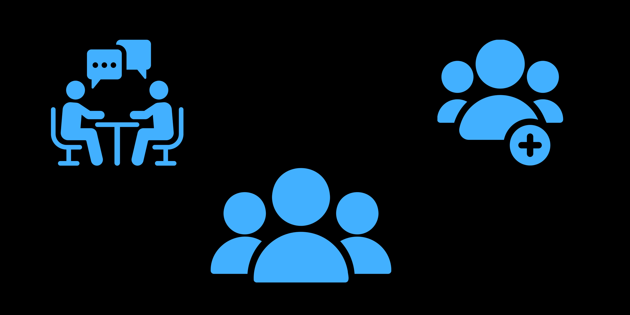
THE ULTIMATE PATH TO EMOTIONAL FREEDOM
YOU CAN CHOOSE THE FOLLOWING:
ONE-TO-ONE PERSONAL FREEDOM
FREEDOM CODE PROGRAM:
GROUP CLASS
FREEDOM CODE PLUS PROGRAM: GROUP CLASS PLUS ONE-TO-ONE THERAPY
Certified by and original © 2025 all rights reserved to vitalitylivingcollege.info.

Slide 106
THE ULTIMATE PATH TO EMOTIONAL FREEDOM
THE FREEDOM CODE IS FOR…
Anyone who is ready to stop just coping with life — and start truly living it.
Those who feel the weight of emotional baggage, silent stress, or past pain…
Are yearning for a gentle but powerful reset — emotionally, mentally, and energetically.
Certified by and original © 2025 all rights reserved to vitalitylivingcollege.info.

Slide 107
THE ULTIMATE PATH TO EMOTIONAL FREEDOM
THE FREEDOM CODE IS FOR YOU, IF YOU:
Are emotionally tired, and want peace of mind and calmness.
Often feel stuck in overthinking, overwhelm, or self-doubt.
Carry pain from the past that still echoes in the present.
Crave deeper emotional balance, inner peace, and personal power.
Done some healing work already, but know there’s more to release.
Want to feel safe in your body, calm in your breath.
Are ready to live from possibility, purpose, and freedom, not fear.
Certified by and original © 2025 all rights reserved to vitalitylivingcollege.info.

Slide 108
THE ULTIMATE PATH TO EMOTIONAL FREEDOM
All you have to do is fill in an intake form to qualify for a complimentary coaching consultation,
normally valued @ $100 USD. You will also get a FREEDOM FROM STRESS manual as a thank you.
Only 9 slots left.
Certified by and original © 2025 all rights reserved to vitalitylivingcollege.info.
Notes:
Explain how many slots you have and that they will go fast.
Either send them a WhatsApp intake form or google form or a link to your website with the button to fill in the form. You can also send the Calendly link where they fill the survey and book an appointment (assuming you have a paid account, or your discovery survey is the same as the consultation survey.)

Slide 109
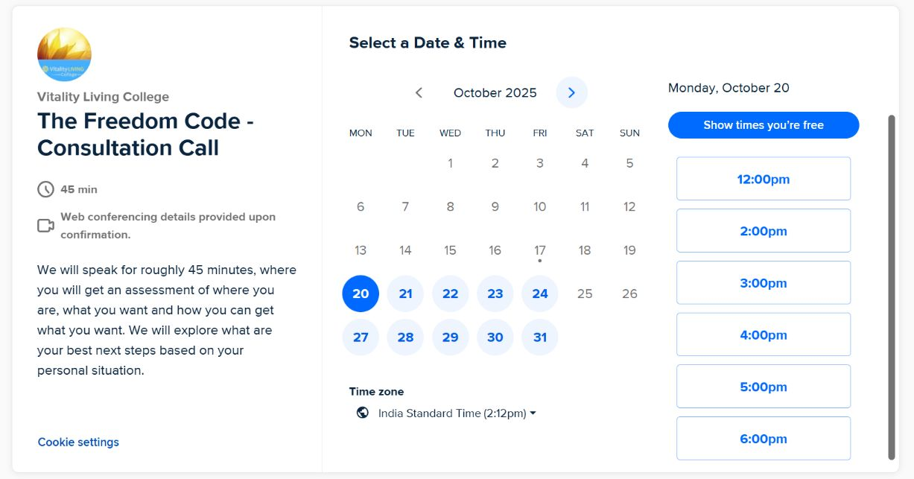
THE ULTIMATE PATH TO EMOTIONAL FREEDOM
Certified by and original © 2025 all rights reserved to vitalitylivingcollege.info.
https://calendly.com/vlcindia/freedom-from-stress-consultation-call?month=2025-10&date=2025-10-20
Notes:
This is now when you directly asking your audience that if they want to take the next step and move from their current situation to their desired situation. If yes, then you would love to have a complimentary coaching call with them.
The only caveat to this is when you are conducting the presentation one-to-one and the natural progression is about talking about your offer in their context. And if this is the case, begin by asking, “how do you feel?” to gauge where they are at? Then ask them what they want and how what you shared in the Discovery Presentation might help them. Let them convince you first that they are ready for the offer.

Slide 110
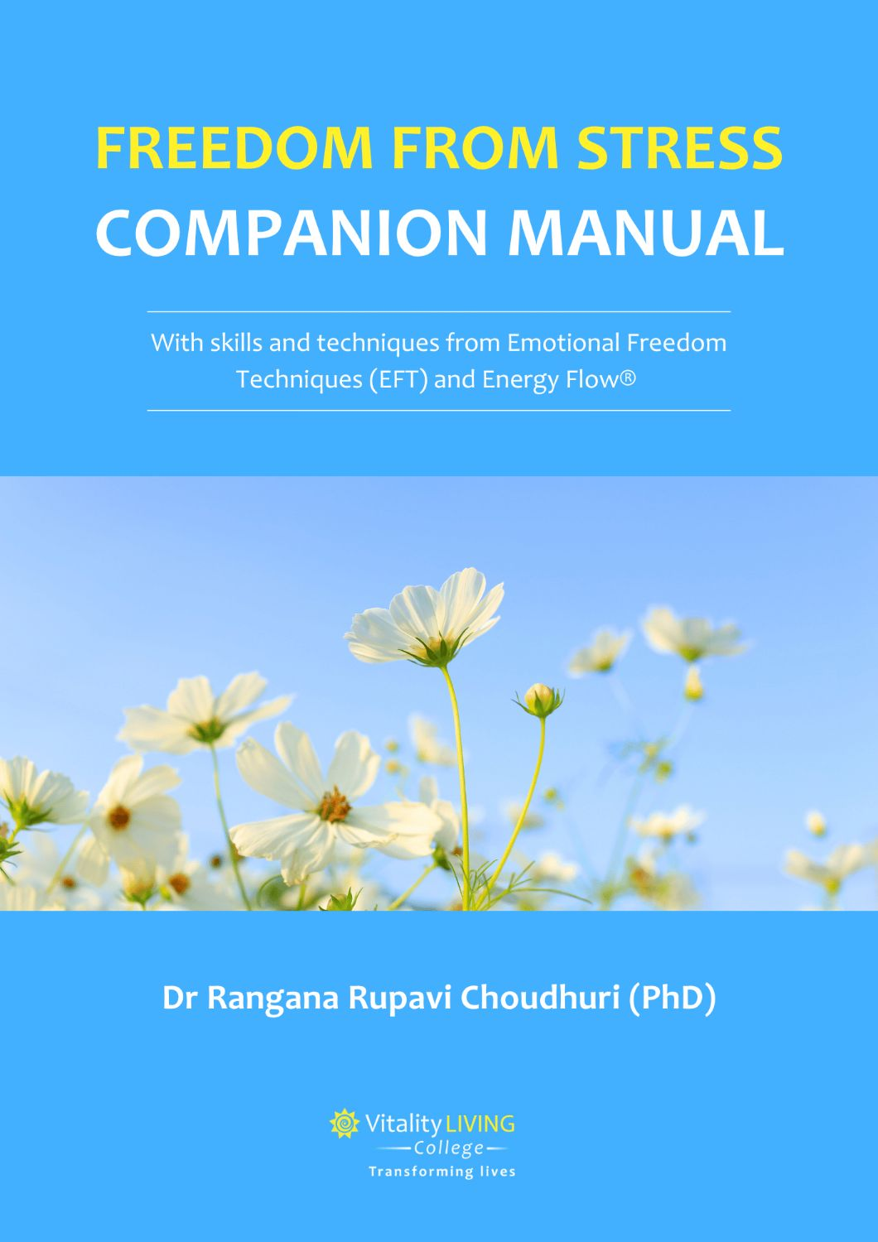
THE ULTIMATE PATH TO EMOTIONAL FREEDOM
Certified by and original © 2025 all rights reserved to vitalitylivingcollege.info.
Notes:
Share about the companion manual

Slide 111
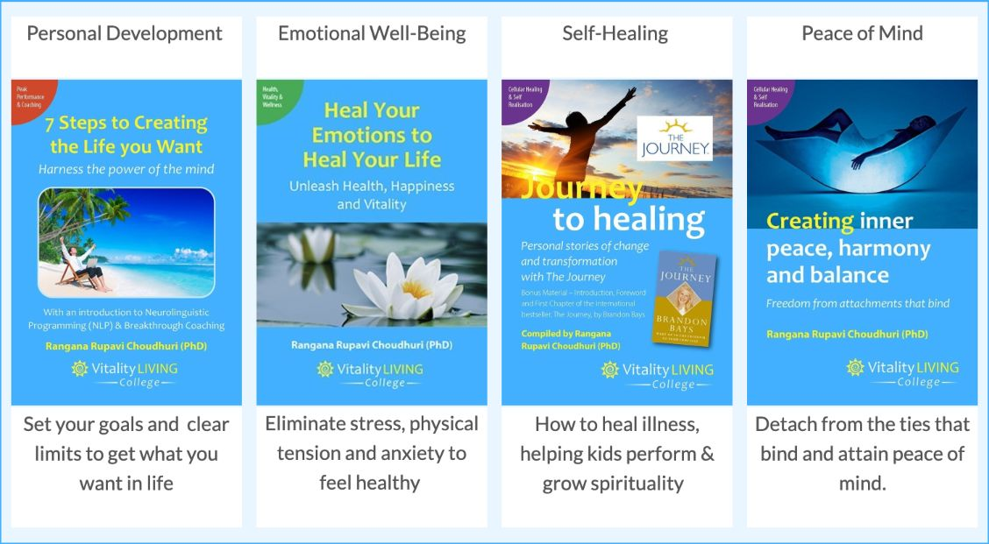
THE ULTIMATE PATH TO EMOTIONAL FREEDOM
https://vitalitylivingcollege.info/free-resources/
Certified by and original © 2025 all rights reserved to vitalitylivingcollege.info.
Notes:
Explain how many slots you have and that they will go fast.
Either send them a WhatsApp intake form or google form or a link to your website with the button to fill in the form. You can also send the Calendly link where they fill the survey and book an appointment (assuming you have a paid account, or your discovery survey is the same as the consultation survey.)

Slide 112
THE ULTIMATE PATH TO EMOTIONAL FREEDOM
SUMMARY
Stress can lead to disease and illness.
Unresolved emotional upsets and trauma can cause disease.
Suppressing emotions is harmful to health.
By releasing stress, freeing suppressed emotions & resolving past trauma you can create health & wellness.
Energy Flow® exercises to release anger, boost the immunity system, and create calmness.
What is EFT and how it is clinically proven to lower stress, anxiety & tension.
The steps to the EFT Process & Energy Flow® exercises.
Certified by and original © 2025 all rights reserved to vitalitylivingcollege.info.

Slide 113

SAY “HI”!
Facebook, https://www.facebook.com/ranganarupavi/
Instagram, https://www.instagram.com/vitalitylivingcollege/
YouTube, https://www.youtube.com/c/VitalityLivingCollege
Certified by and original © 2025 all rights reserved to vitalitylivingcollege.info.
Notes:
Add your picture and social media handles.

Slide 114
SAY “HI”!
Facebook, add yours
Instagram, add yours
YouTube, add yours
YOUR PICTURE
Certified by and original © 2025 all rights reserved to vitalitylivingcollege.info.
Notes:
Add your picture and social media handles.

Slide 115
THE FAST & EASY PATH TO PEACE & CALM
FREEDOM FROM STRESS
THE ULTIMATE PATH TO PEACE
With Emotional Freedom Techniques (EFT) & Energy Flow®

