Slide 1
FREEDOM FROM STRESS
with Emotional Wellness

Slide 2
MODULE 1: INTRODUCTION

Slide 3
A state of mental or emotional strain or tension resulting from adverse or demanding
circumstances.

Slide 4



What are the symptoms of stress?

Slide 5

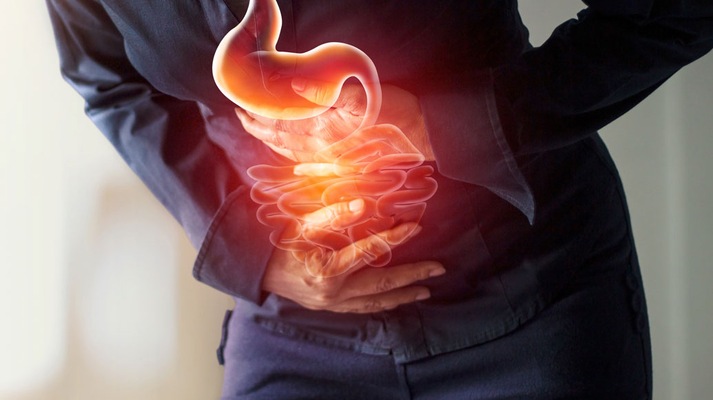

What are the symptoms of stress?

Slide 6

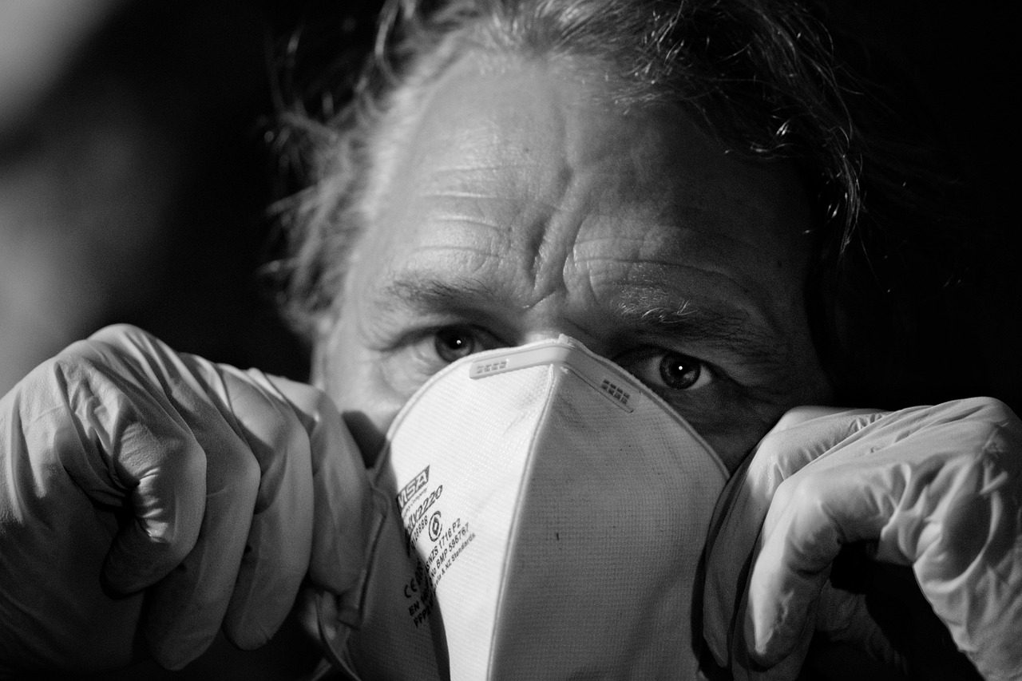

What are the symptoms of stress?

Slide 7
In our time today, we will cover:
  What is at the root cause of stress & illness?
  How to reverse the negative effects of stress?
  What is Energy Yoga and how can it relieve stress?
  What is Emotional Freedom Techniques (EFT) and how can it help to create health?

Slide 8





Rangana Choudhuri (PhD)
Diagnosed with Cancer in 2001, then self healed with alternate therapy and coaching
Used to get a daily migraine, debilitating pain in the neck and shoulders
Learned a clinically proven technique, EFT Tapping, which calms down stress in seconds to have no more migraines
Have coached and supported 1000s of people in one-to-one session and trained over 20,000+ people to feel calm, healthy, happy and at peace

Slide 9
Life and Mental Health Audit
Rate yourself on the following (10 is highest, 1 lowest)
How happy do you feel?
How stressed do you feel?
How well are you sleeping?
How anxious do you get?
How often do you get triggered?

Slide 10
85%
of illness is Stress!

Slide 11
90%
of doctor visits are stress related!

Slide 12
LEADING CAUSE
of divorce, weight gain, obesity & addictions

Slide 13
UNRESOLVED
emotional upsets lead to illness

Slide 14
SUPRRESSED EMOTIONS
increase risk of cancer by 70%
and heart disease by 47%

Slide 15
UNEXPRESSED ANGER
is known to be linked to cancer
Notes:
TANTRUM TAPPING

Slide 16
TANTRUM TAPPING
Place the fingers just under the collarbone
Take a breath in and out and make a loud ahhh sound as if letting out all negativity
Stamp the feet as if having a tantrum

Slide 17
UNFORGIVENESS
can lead to diabetes, pain and heart attack

Slide 18
So, what can you do?
Figure out a way that works to release stress
Use a clinically proven method to free suppressed emotions
Learn a method to let go of the past upsets and trauma

Slide 19



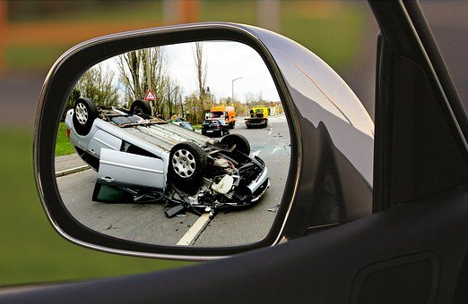
Emotional Freedom Technique (EFT)
Overcome stress
Eliminate pain
Heal the past
Defeat phobias
Heal past trauma & accidents
Stop cravings
Breakthrough limits

Slide 20
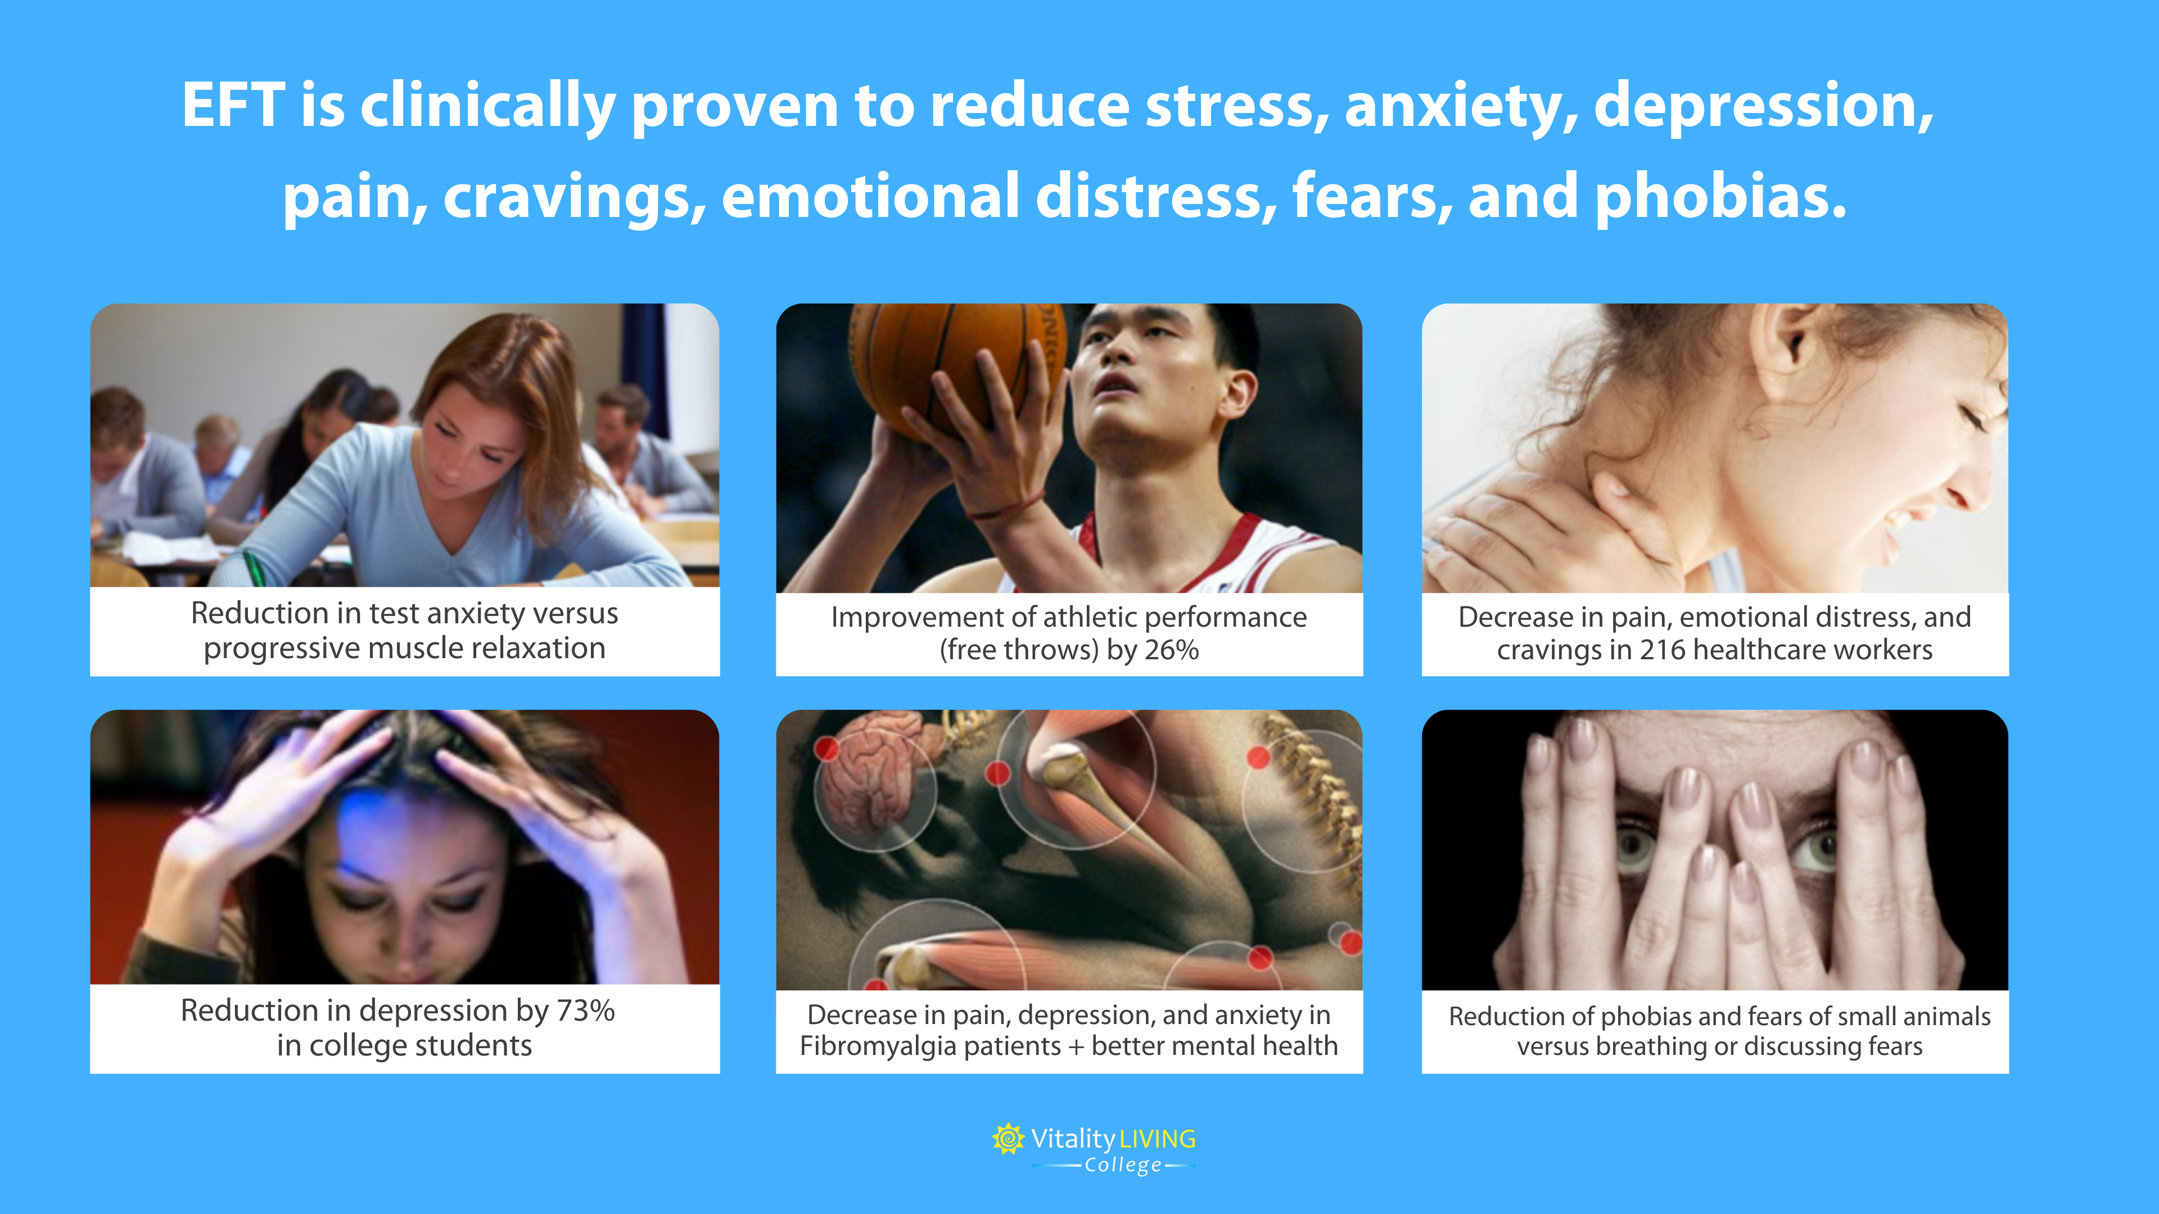

Slide 21
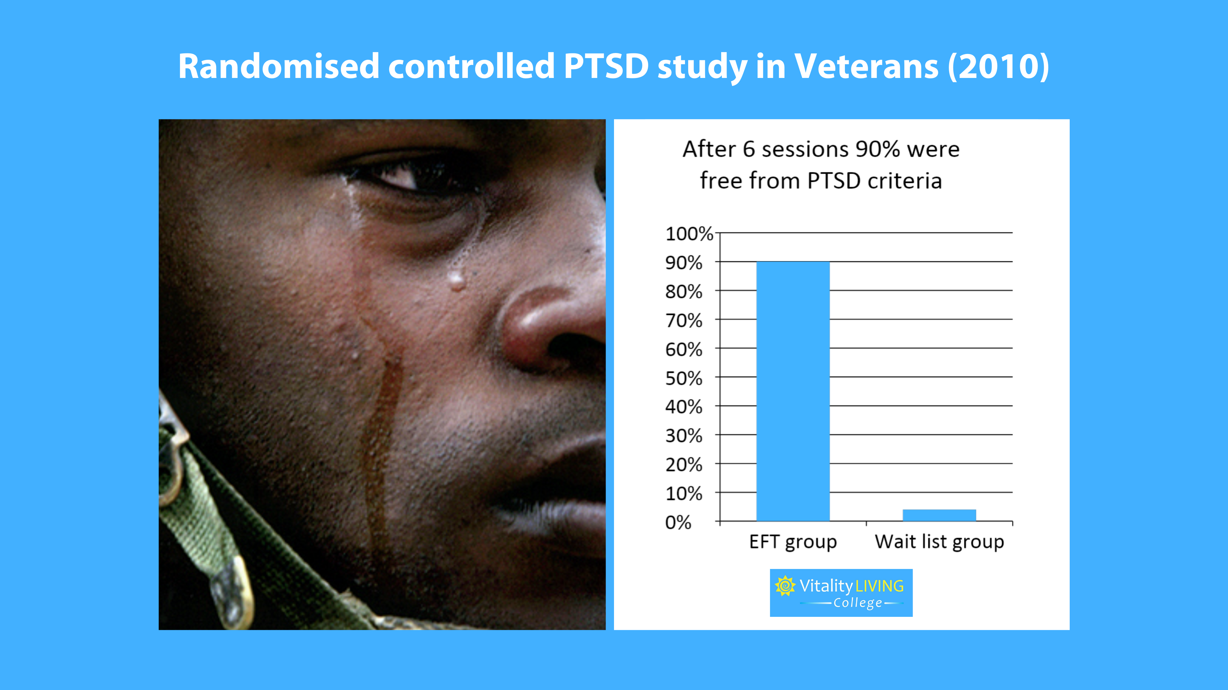

Slide 22
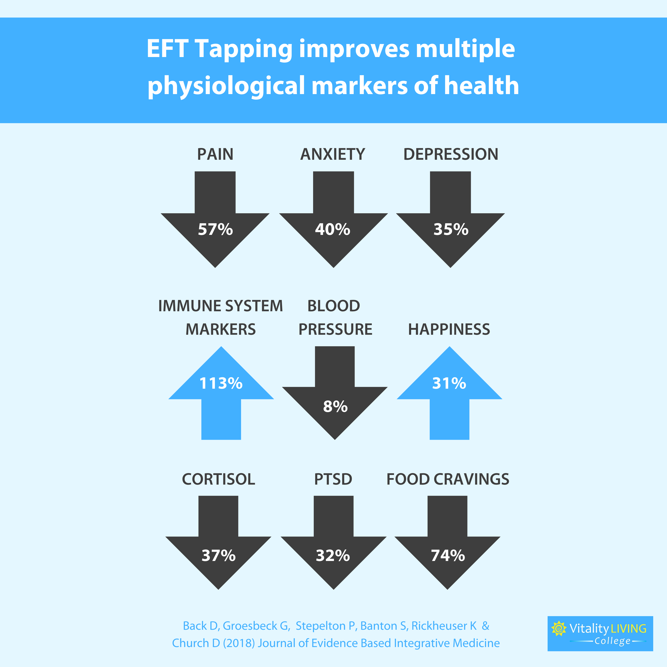

Slide 23
IMMUNE BOOSTING
Make a gentle fist with the hand
Find the thymus point of breast bone
Gently thump while making an aaahhh… sound
The sound reverberates, as if you are getting a head massage or like Tarzan

Slide 24
The 7 Steps of EFT
Identify the issue or goal
Get a measure for it
Start EFT Tapping on the side of the hand
Tap on the upper body and facial points
Close sequence
Relax
Testing

Slide 26
Anxiety
Auto Accident
Boredom
Claustrophobia
Depression
Grief
Guilt
Headache
Insomnia
Limiting Beliefs
Love Pain
Physical Pain
Panic attack
Sadness
Shame
Stress
Self Image
Sexual Abuse
Sports Issues
Trauma
War memories
Weight Loss
Phobias/Fears
      Public Speaking
      Dentist
      Rats
      Spiders
      Roaches
      Needles
      Driving
      Snakes
      Heights
      Water

Slide 27

Summary
Stress can lead to disease and illness
Unresolved emotional upsets can cause disease
Suppressing emotions is harmful to health
By releasing stress, freeing suppressed emotions & resolving past upset you can create health & wellness
How EFT is clinically proven to lower stress, anxiety & tension
The steps to the EFT Process & Energy Yoga exercises

Slide 28

Say “Hi”!
Facebook, https://www.facebook.com/ranganarupavi/
Instagram, https://www.instagram.com/vitalitylivingcollege/
You Tube, https://www.youtube.com/c/VitalityLivingCollege

Slide 29
FREEDOM FROM STRESS
HELP YOURSELF & OTHERS HEAL
with Emotional Wellness

Slide 30
MODULE 2: RELEASING PHYSICAL TENSION

Slide 31
Summary
Tension can be held in the body
Recap EFT Tapping
Physical tension process
Group tapping
Borrowing benefits demonstrations
Group positive tapping
Share your learnings and insights

Slide 32
MODULE 3: FREEING STRESS

Slide 33
Summary
Stress is normal but too much stress can be too much
Recap EFT Tapping
What stresses you out?
Group tapping / Tantrum tapping / Stress release
Borrowing benefits demonstrations
Group positive tapping
Share your learnings and insights

Slide 34
MODULE 5: MELTING WORRY

Slide 35
Summary
Worry is completely ok. It is a sign that you want something to change
Recap EFT Tapping
What makes you feel worried?
Hair Combing / Crown pulling / Forehead pulling
Borrowing benefits demonstrations
Group positive tapping
Share your learnings and insights

Slide 36
MODULE 5: OPENING TO RELAXATION

Slide 37
Summary
A relaxed mind is a relaxed body and vice versa
Recap EFT Tapping
What prevents you from relaxing
Finger holds / Heart Hold 6 Count Breathing
Borrowing benefits demonstrations
Group tapping positive
Share your learnings and insights

Slide 38
MODULE 6: INTEGRATION

Slide 39
Summary
Audit
Recap EFT Tapping
Finger holds / Triple Point Calmer
Group positive tapping
Get audience to share their learnings and testimonials
Next steps

